Slide 1
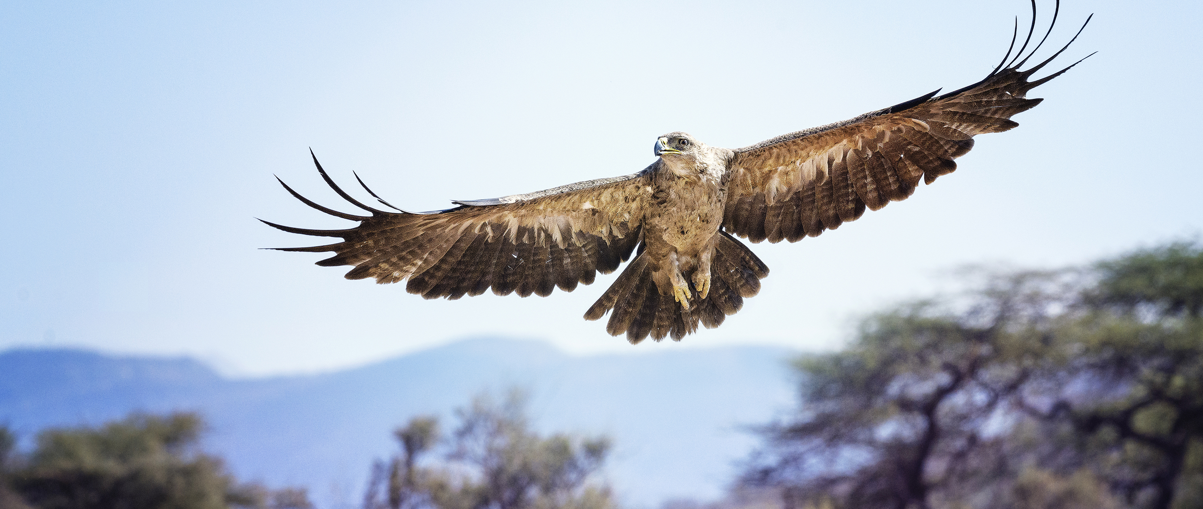
ASD-N Annual First Nation Education Report
2021-2022
Prepared by: ASD-N First Nation Education Team

Slide 2
Overview
Professional Learning
Enhancement Agreement
DWF Legacy District for Reconciliation Partnership
Truth and Reconciliation Week
Elders in Schools
Mawi'omi's (Pow Wow's)
Blanket Exercises
Am"bear"isters
Partnerships
Tell Them From me
Challenges & Areas For Growth

Slide 3
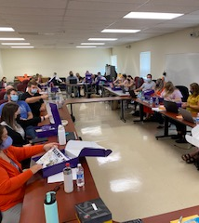
Professional Learning
2 paid professional learning opportunities (February/March 2022)
Deepened Understanding of Mi'kmaq Culture (16 participants)
Elders in Schools (8 participants)
2 sessions of voluntary professional learning offered at Bathurst High School for Parkwood Elementary School, Terry Fox School, Superior Middle School, and Bathurst High School staff
Deepened Understanding of Mi'kmaq Culture
1 school initiated full-staff session at Miramichi Rural School
Deepened Understanding of Mi'kmaq Culture

Slide 4
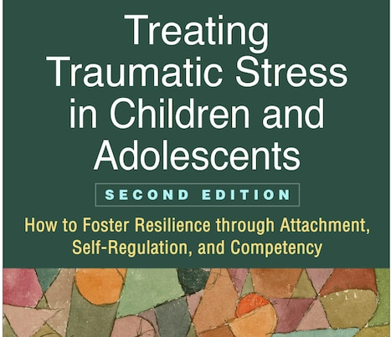
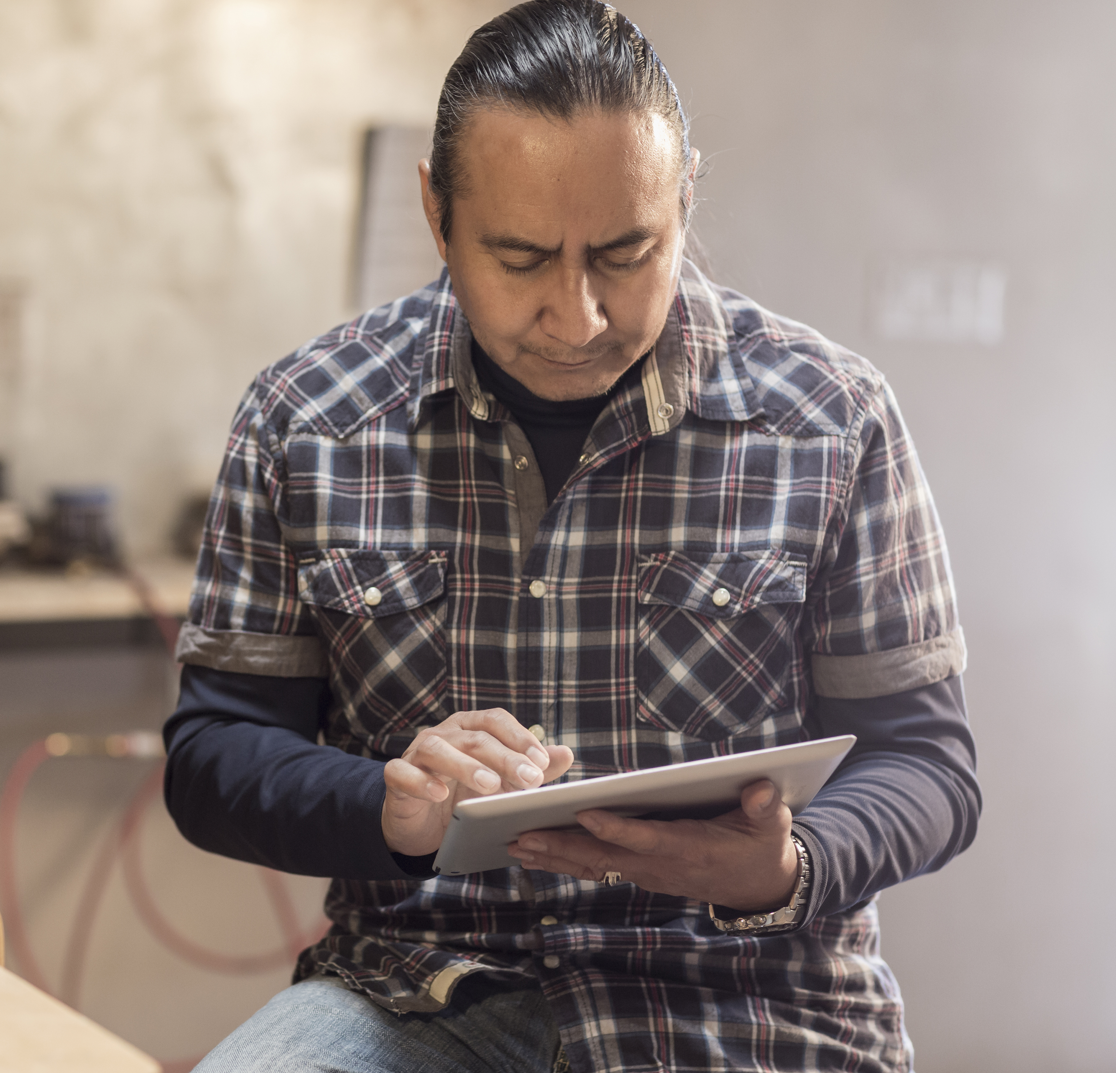
ARC Training
Over 100 ASD-N staff and enhancement employees received Attachment, Regulation and Competency training
12 credit hour certificate course facilitated asynchronously by Dr. Margaret Blaustein.
ASD-N will be offering this course again in 2022-2023

Slide 5
Enhanced First Nation Education Programs & Services Agreement
ASD-N and First Nation Communities have continued to meet as required by the agreement.
Positive growth in academics, school environment and relationships continue in First Nation Education

Slide 6
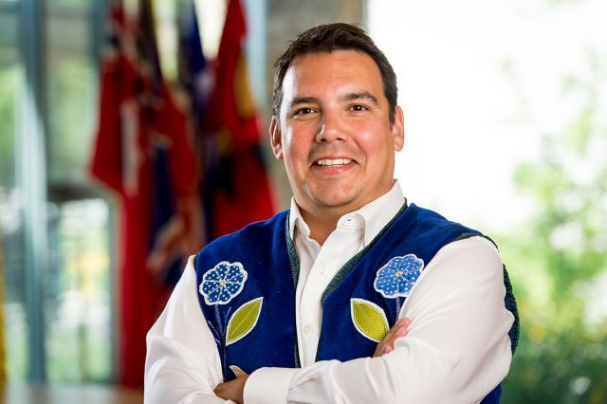
DWF Legacy District for Reconciliation
Supported by the Downey Wenjack Fund, one or more Champions were identified at each school in ASD-N
Kickoff to the year - two days of professional learning for all Champions
Day I: Welcome, resource distribution, goal setting
Day II: Climbing the Mountain: Educating for Reconciliation in Canada with Dr. Niigaan Sinclair

Slide 7
DWF Partnership – Champion & School Support
In response to Champion feedback, the following supports were made available:
Two release days per school champion
$500 Do Something grants to each school to implement projects
Resource delivery to schools through champions to empower their leadership among staff and to ensure they are familiar with available resources

Slide 8
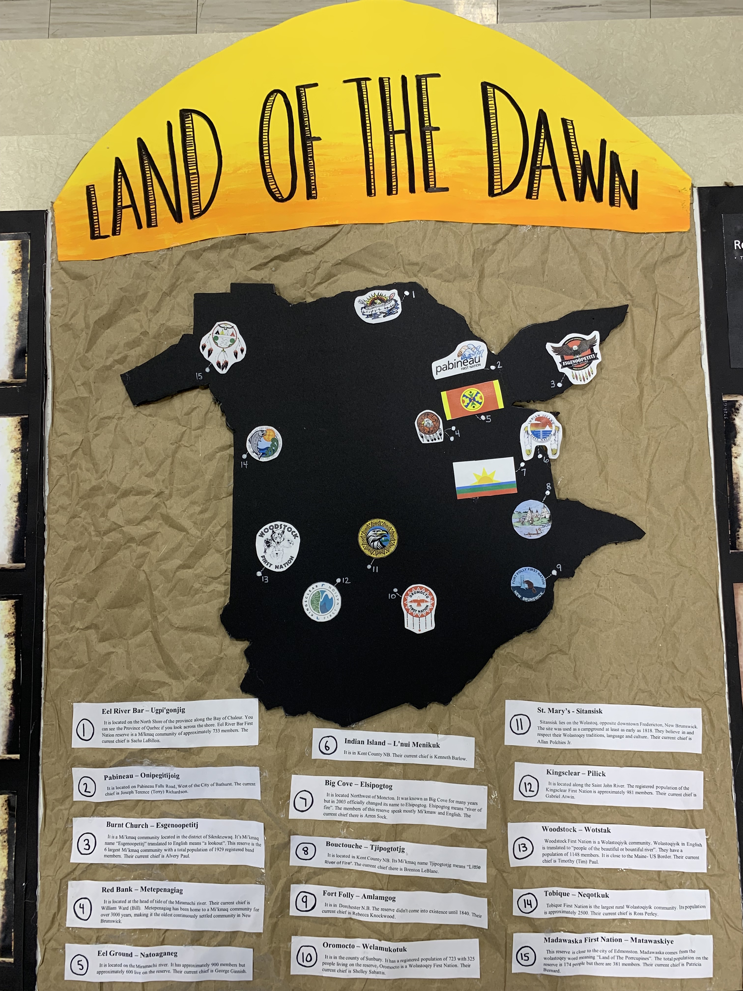
DWF Outcomes
Do Something Grant: Evidence of Success
Student-written land acknowledgements
Lord Beaverbrook School
Blackville School
Library upgrades
Dr. Losier Middle School
James M. Hill Memorial High School
Napan Elementary School
School displays
Bathurst High School
Bonar Law Memorial High School
Dr. Losier Middle School
James M Hill
King Street Elementary
Lord Beaverbrook School
Napan Elementary
Rexton Elementary

Slide 9
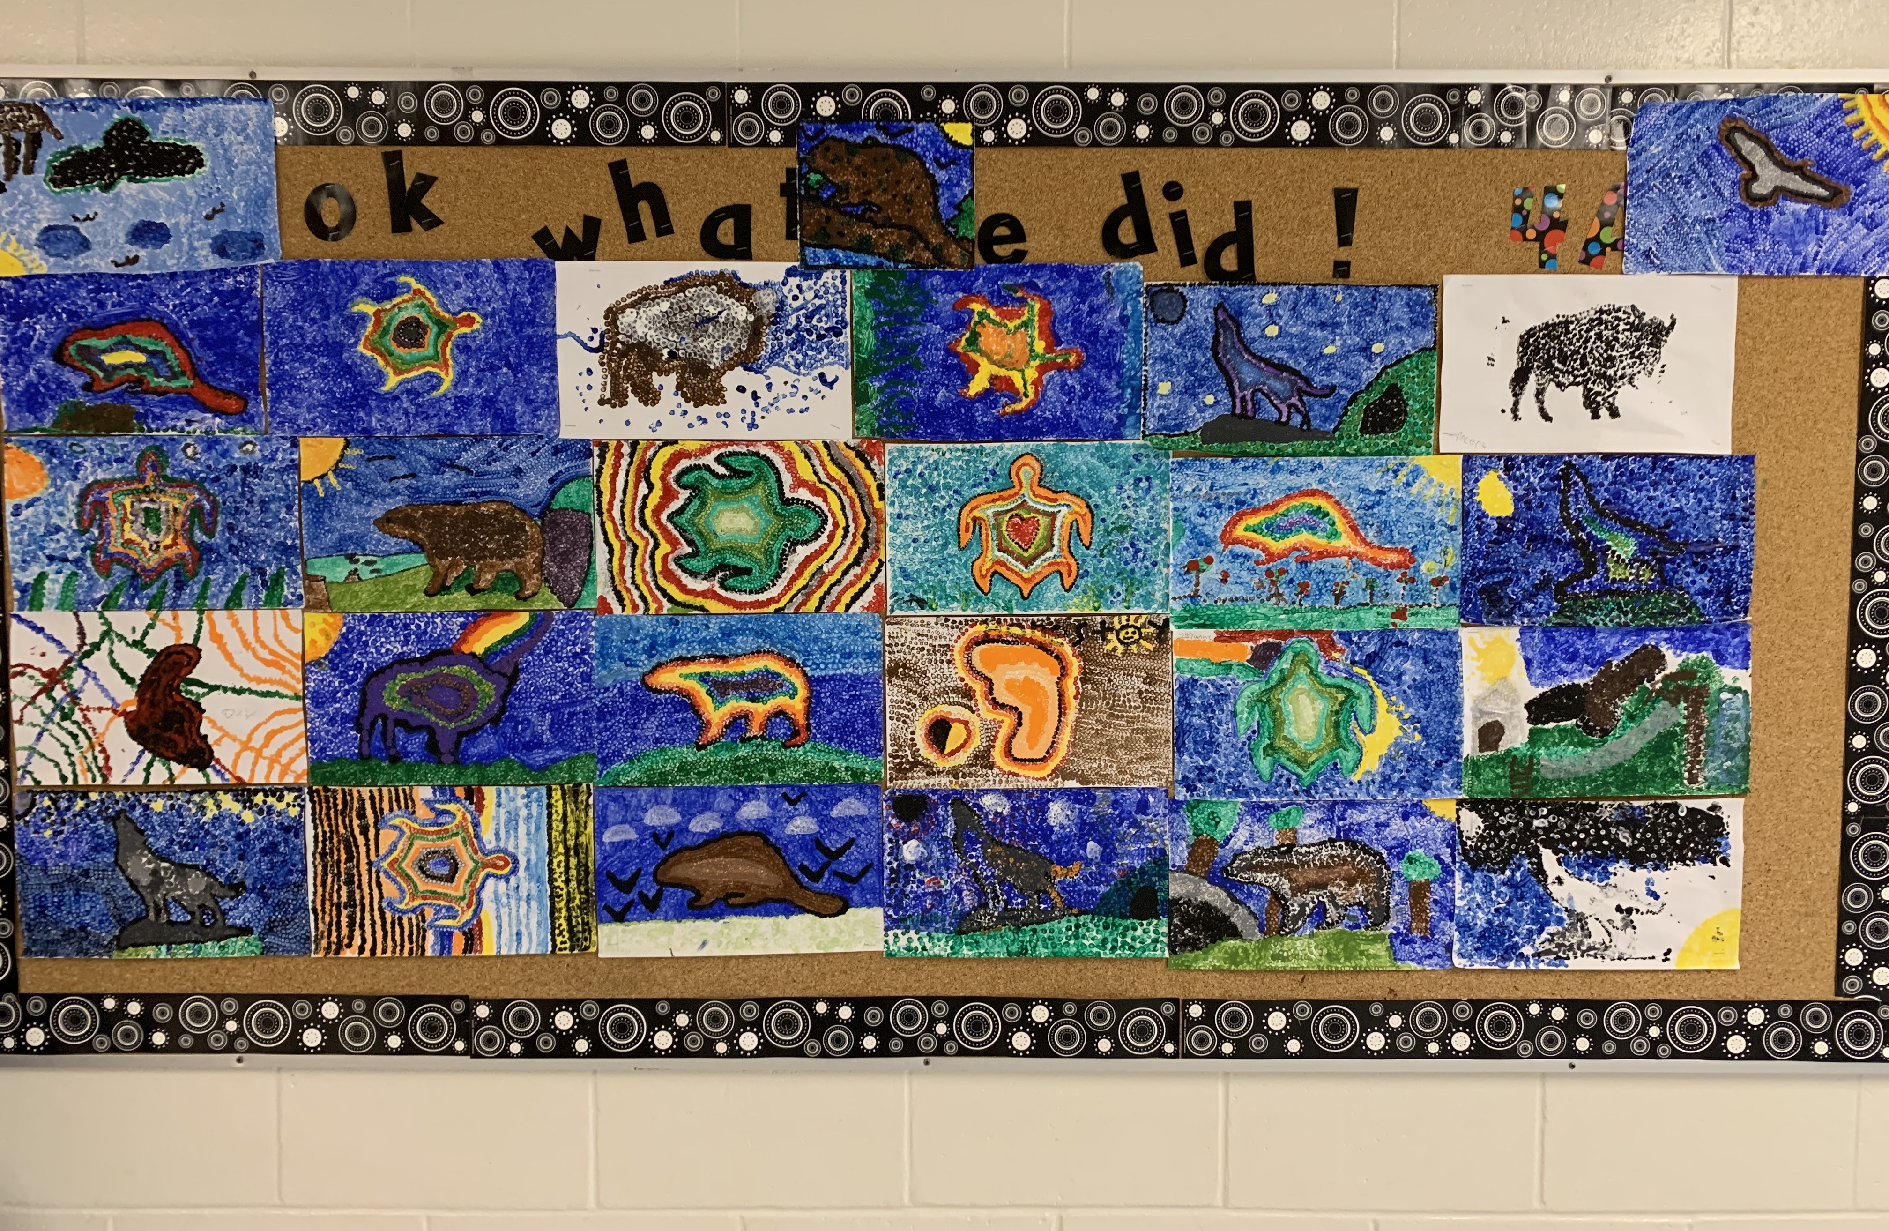
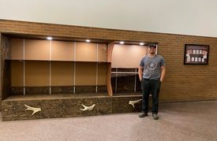
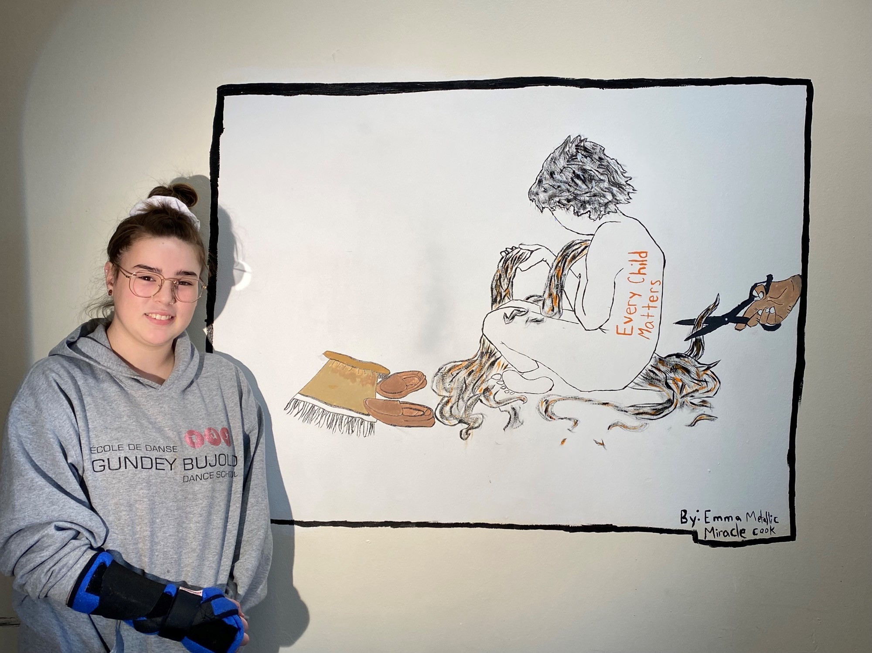
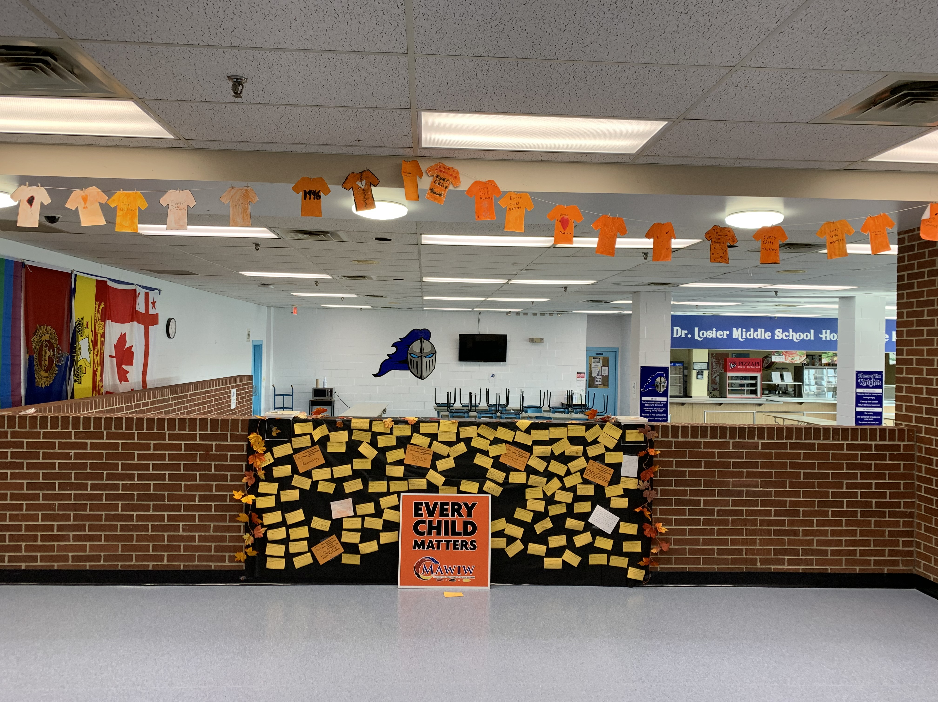

Slide 10
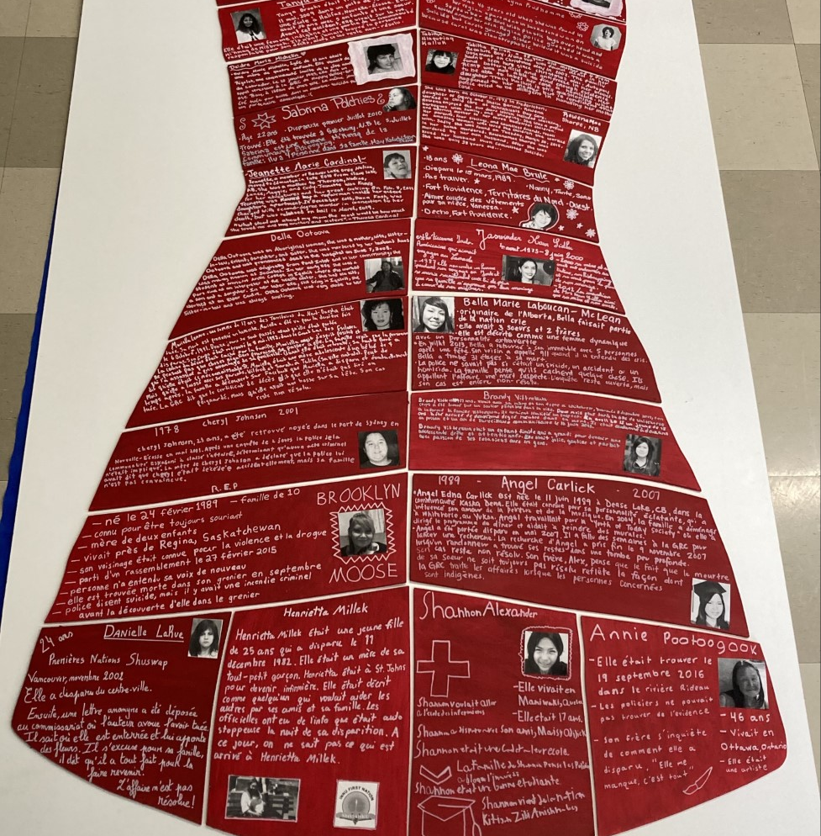
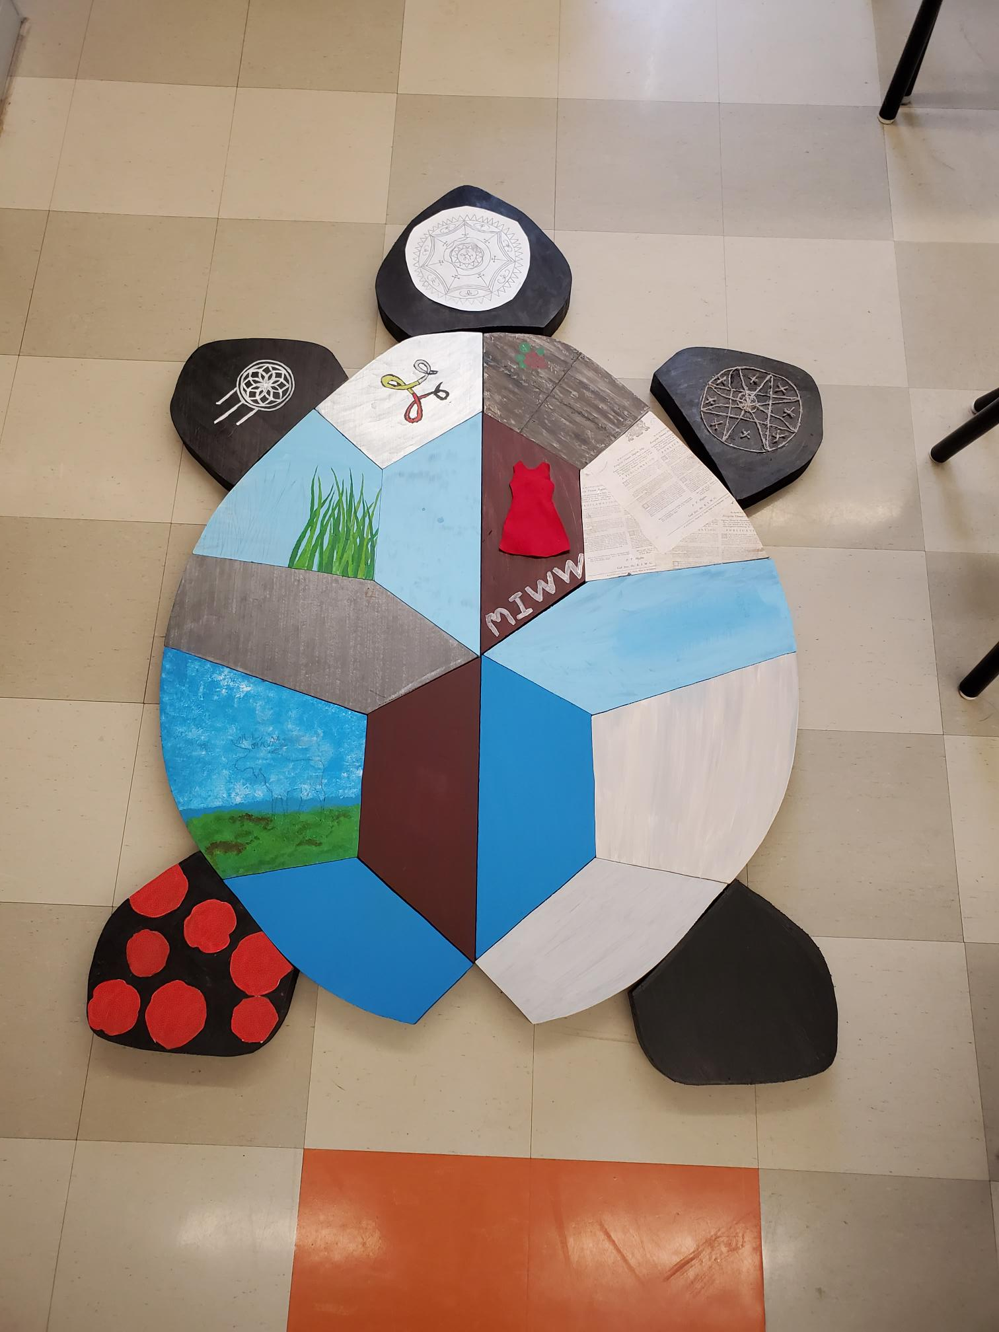
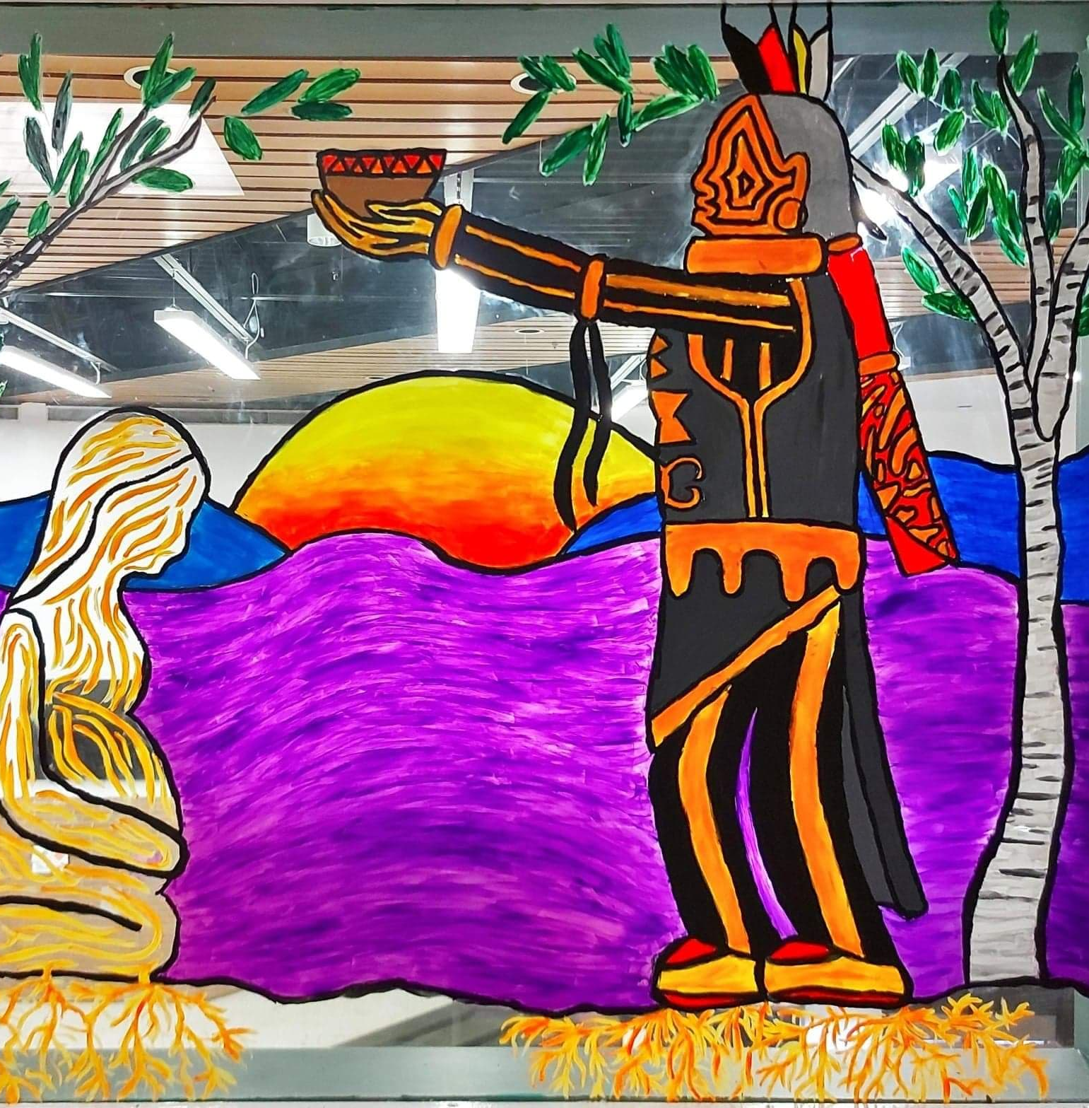
DWF Outcomes continued
Arts and Culture Projects
Bathurst High School
Bonar Law Memorial
Eleanor W. Graham
Max Aitken Academy
NSER
Parkwood Elementary School​
Rexton Elementary​
Superior Middle School​
Terry Fox Elementary

Slide 11
Truth and Reconciliation Week
In addition to providing curricular support to teachers for Orange Shirt Day and Truth and Reconciliation Week, the FNE team supported many special projects across the district.
Orange T-Shirt Project
Students at Max Aitken Academy hand-produced 600 orange t-shirts and 150 buttons and distributed them across ASD-N
Total sales = $11,734
Sales were matched by ASD-N and donated to Ugpi'ganjig Elders, The Orange Shirt Society, Natoaganeg Community Food Center, and the Residential School Survivor Society

Slide 12
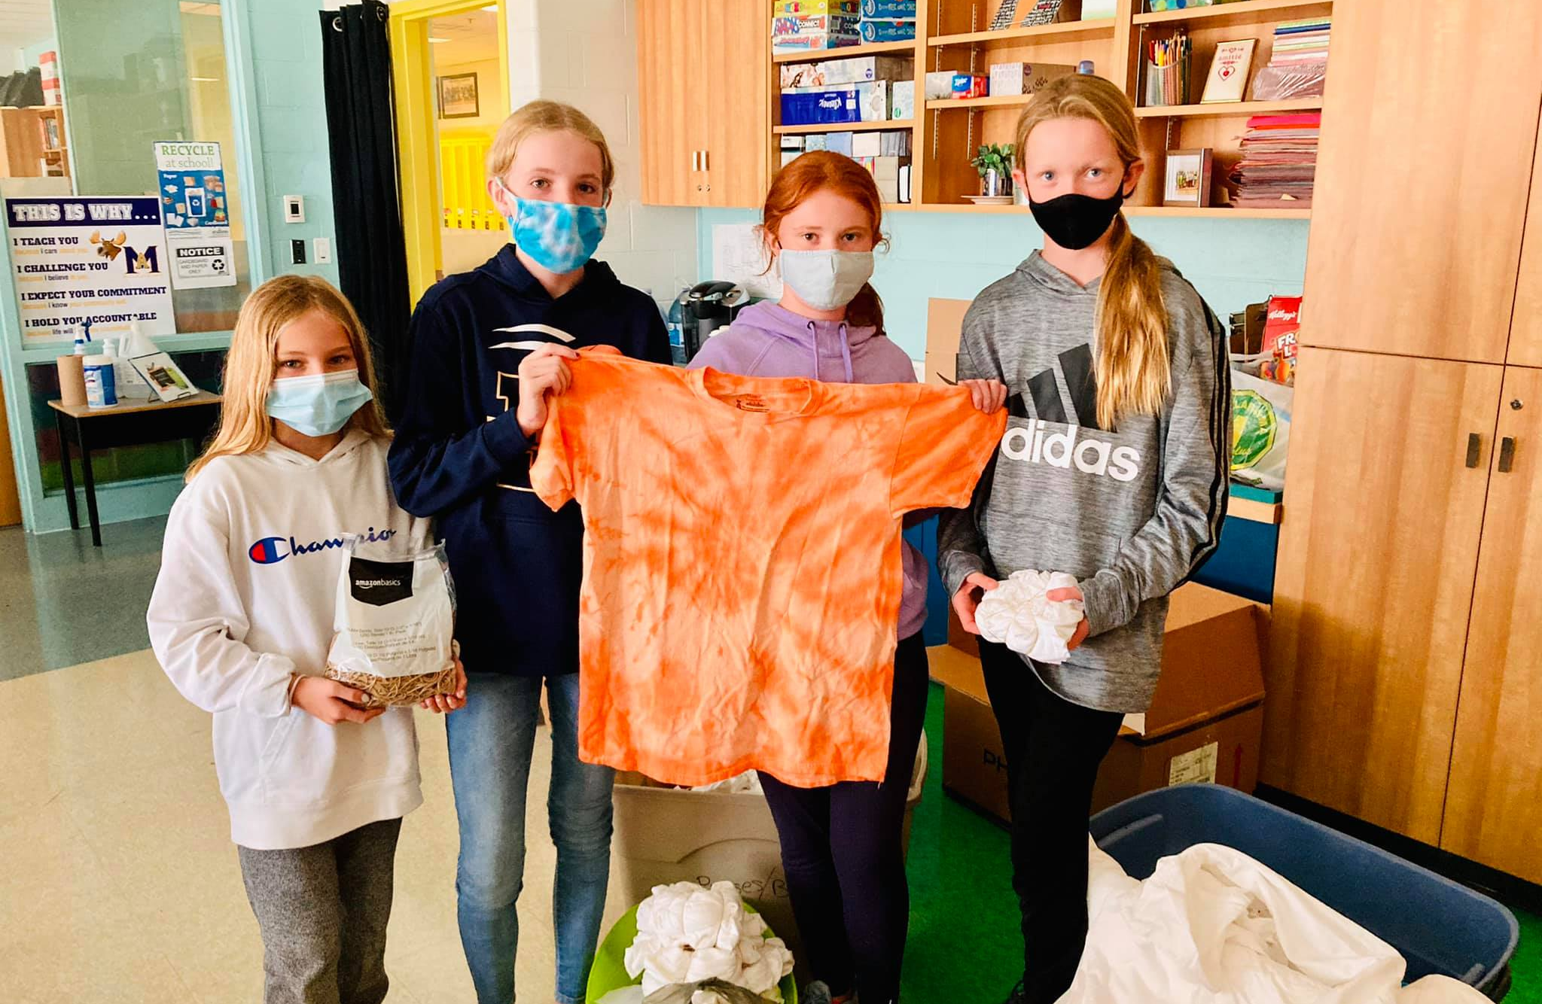
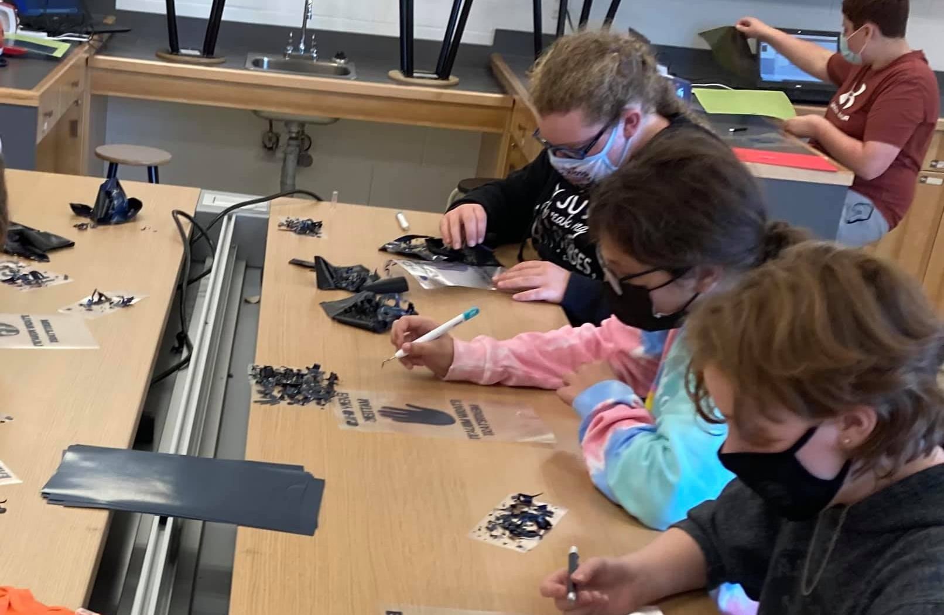
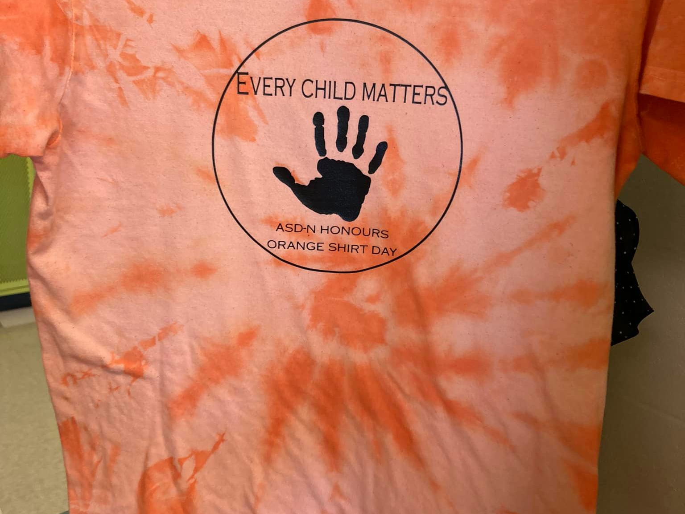
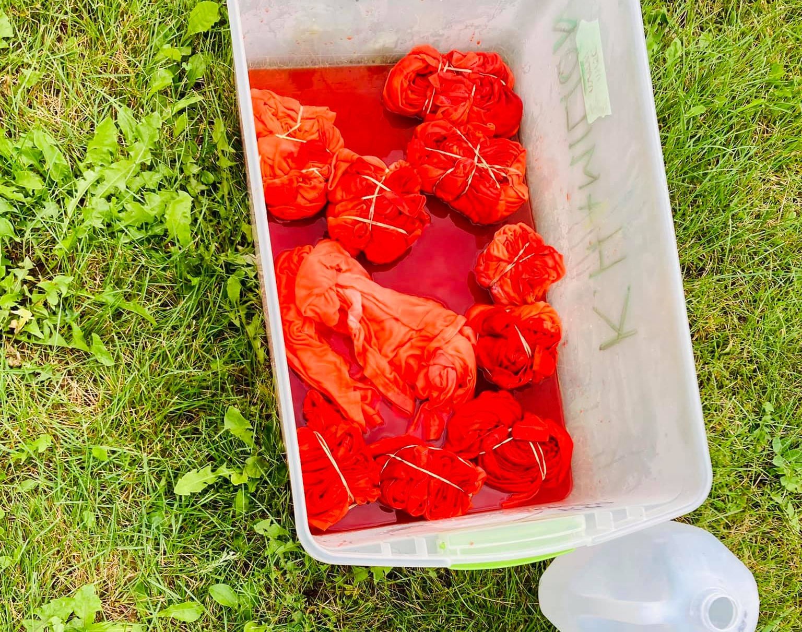
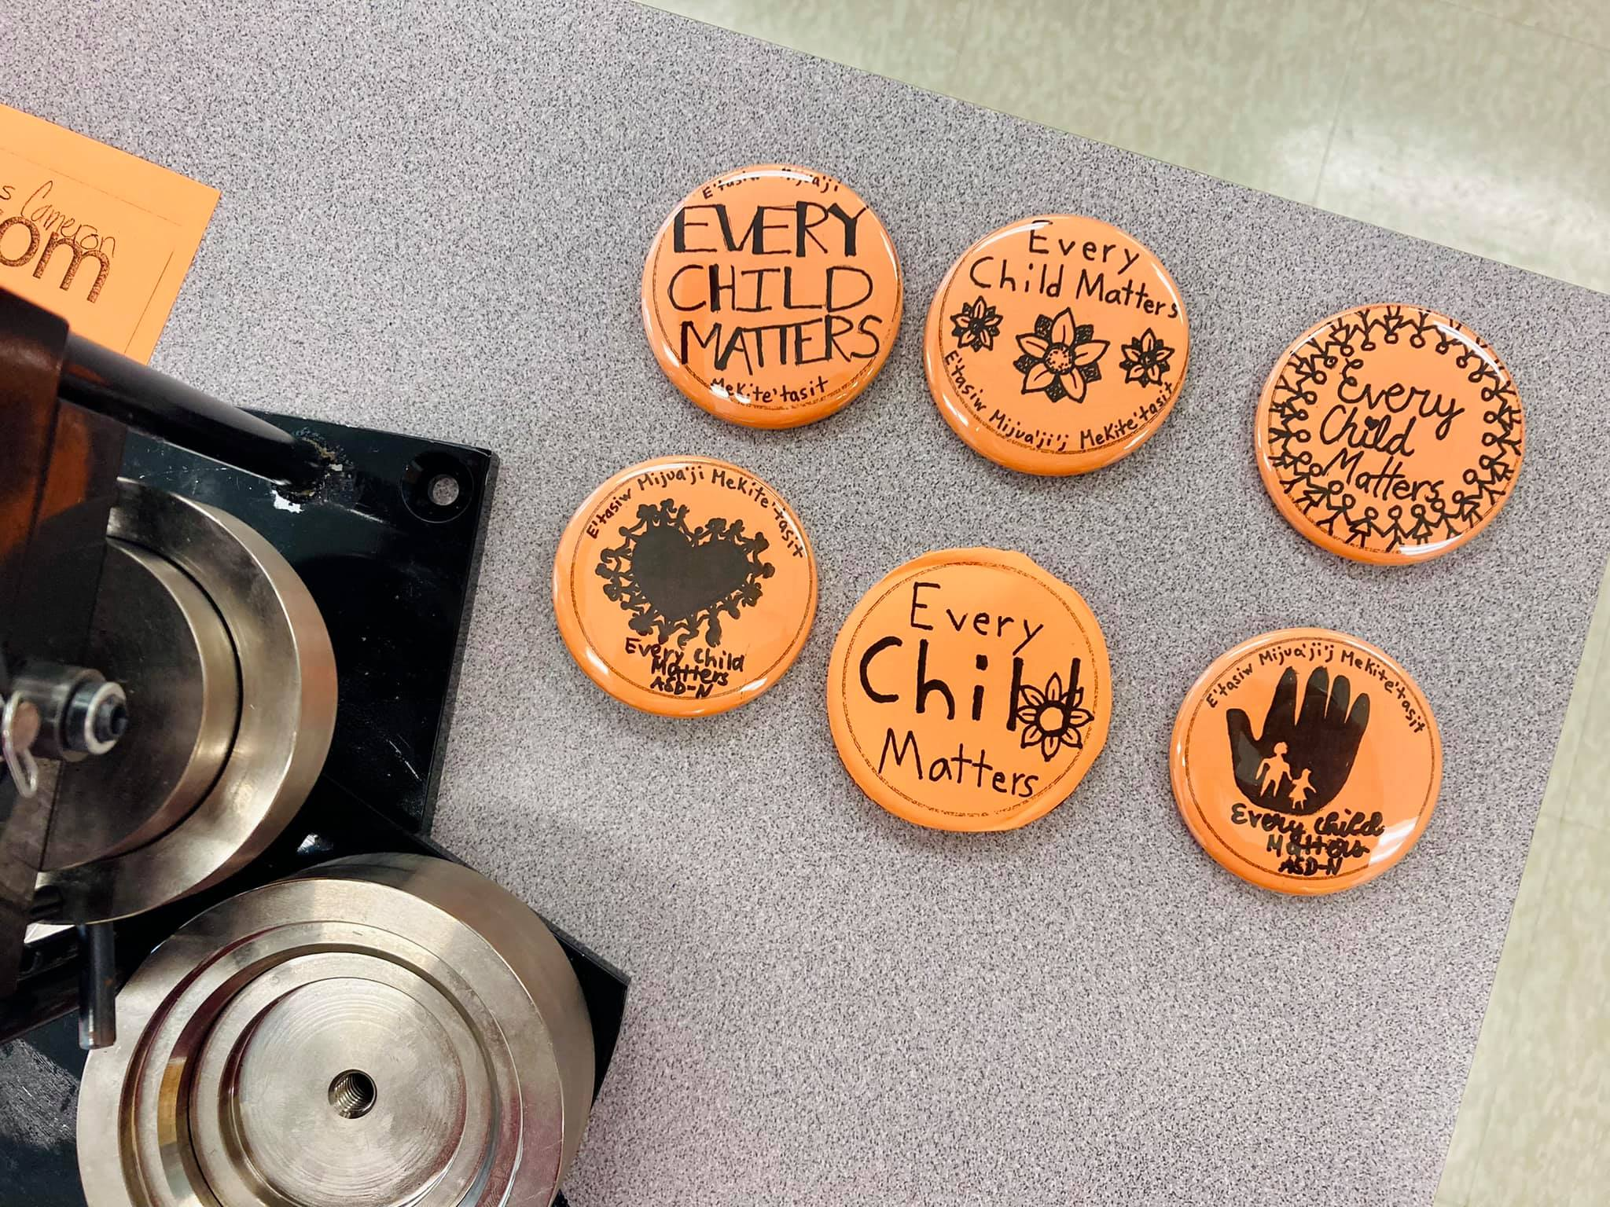

Slide 13
Elders in Schools
Professional Learning
Unanimous positive feedback from educators
Led to a rise in requests for Elders in Schools
Fostered a baseline relationship between educators and Elders before classroom visits, which led to more positive visits for students, educators and Elders alike
Elders' gathering
Provided an opportunity for Elders to engage with one another
Reflection on experiences in classrooms – successes and challenges
Planning: Elders provided feedback on needs and goals for the future of the program

Slide 14
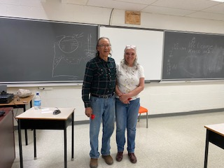
Elders in Schools
Classroom visits
Over half of ASD-N schools participated in the program
Notable successes:
Weekly visits at L.E. Reinsborough School with Elder Roseann Martin resulting in a song recording by kindergarten students
Weekly visits with First Nations Visual Arts 110 students with Elder Joseph Leonard Ward and Sarah Ward resulting in completed moccasins
Weekly visits with Superior Middle School, Terry Fox and Parkwood Elementary by Marie Kryszko to learn about the Seven Sacred Teachings, ending with a trip to Pabineau First Nation

Slide 15
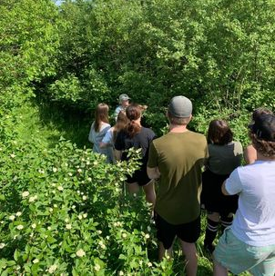
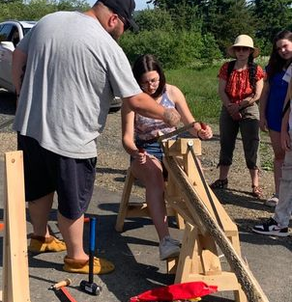
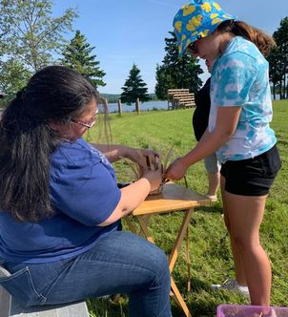
Take Me Outside
The middle school students of DRHS spent a full day at the Aboriginal Heritage Gardens in Eel River Bar in June. They learned how the ash tree is connected to Mi'kmaq creation, scraped and pounded ash for baskets, helped weave a basket of their own, went on a medicine walk, and played games before indulging in a feast of moose stew and luskinigan.

Slide 16
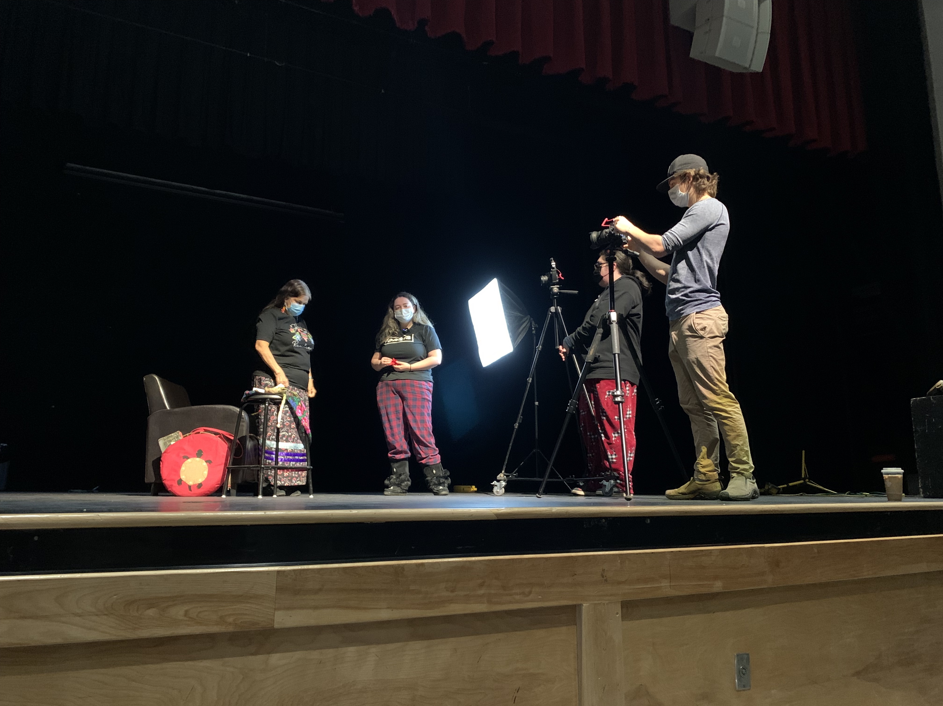
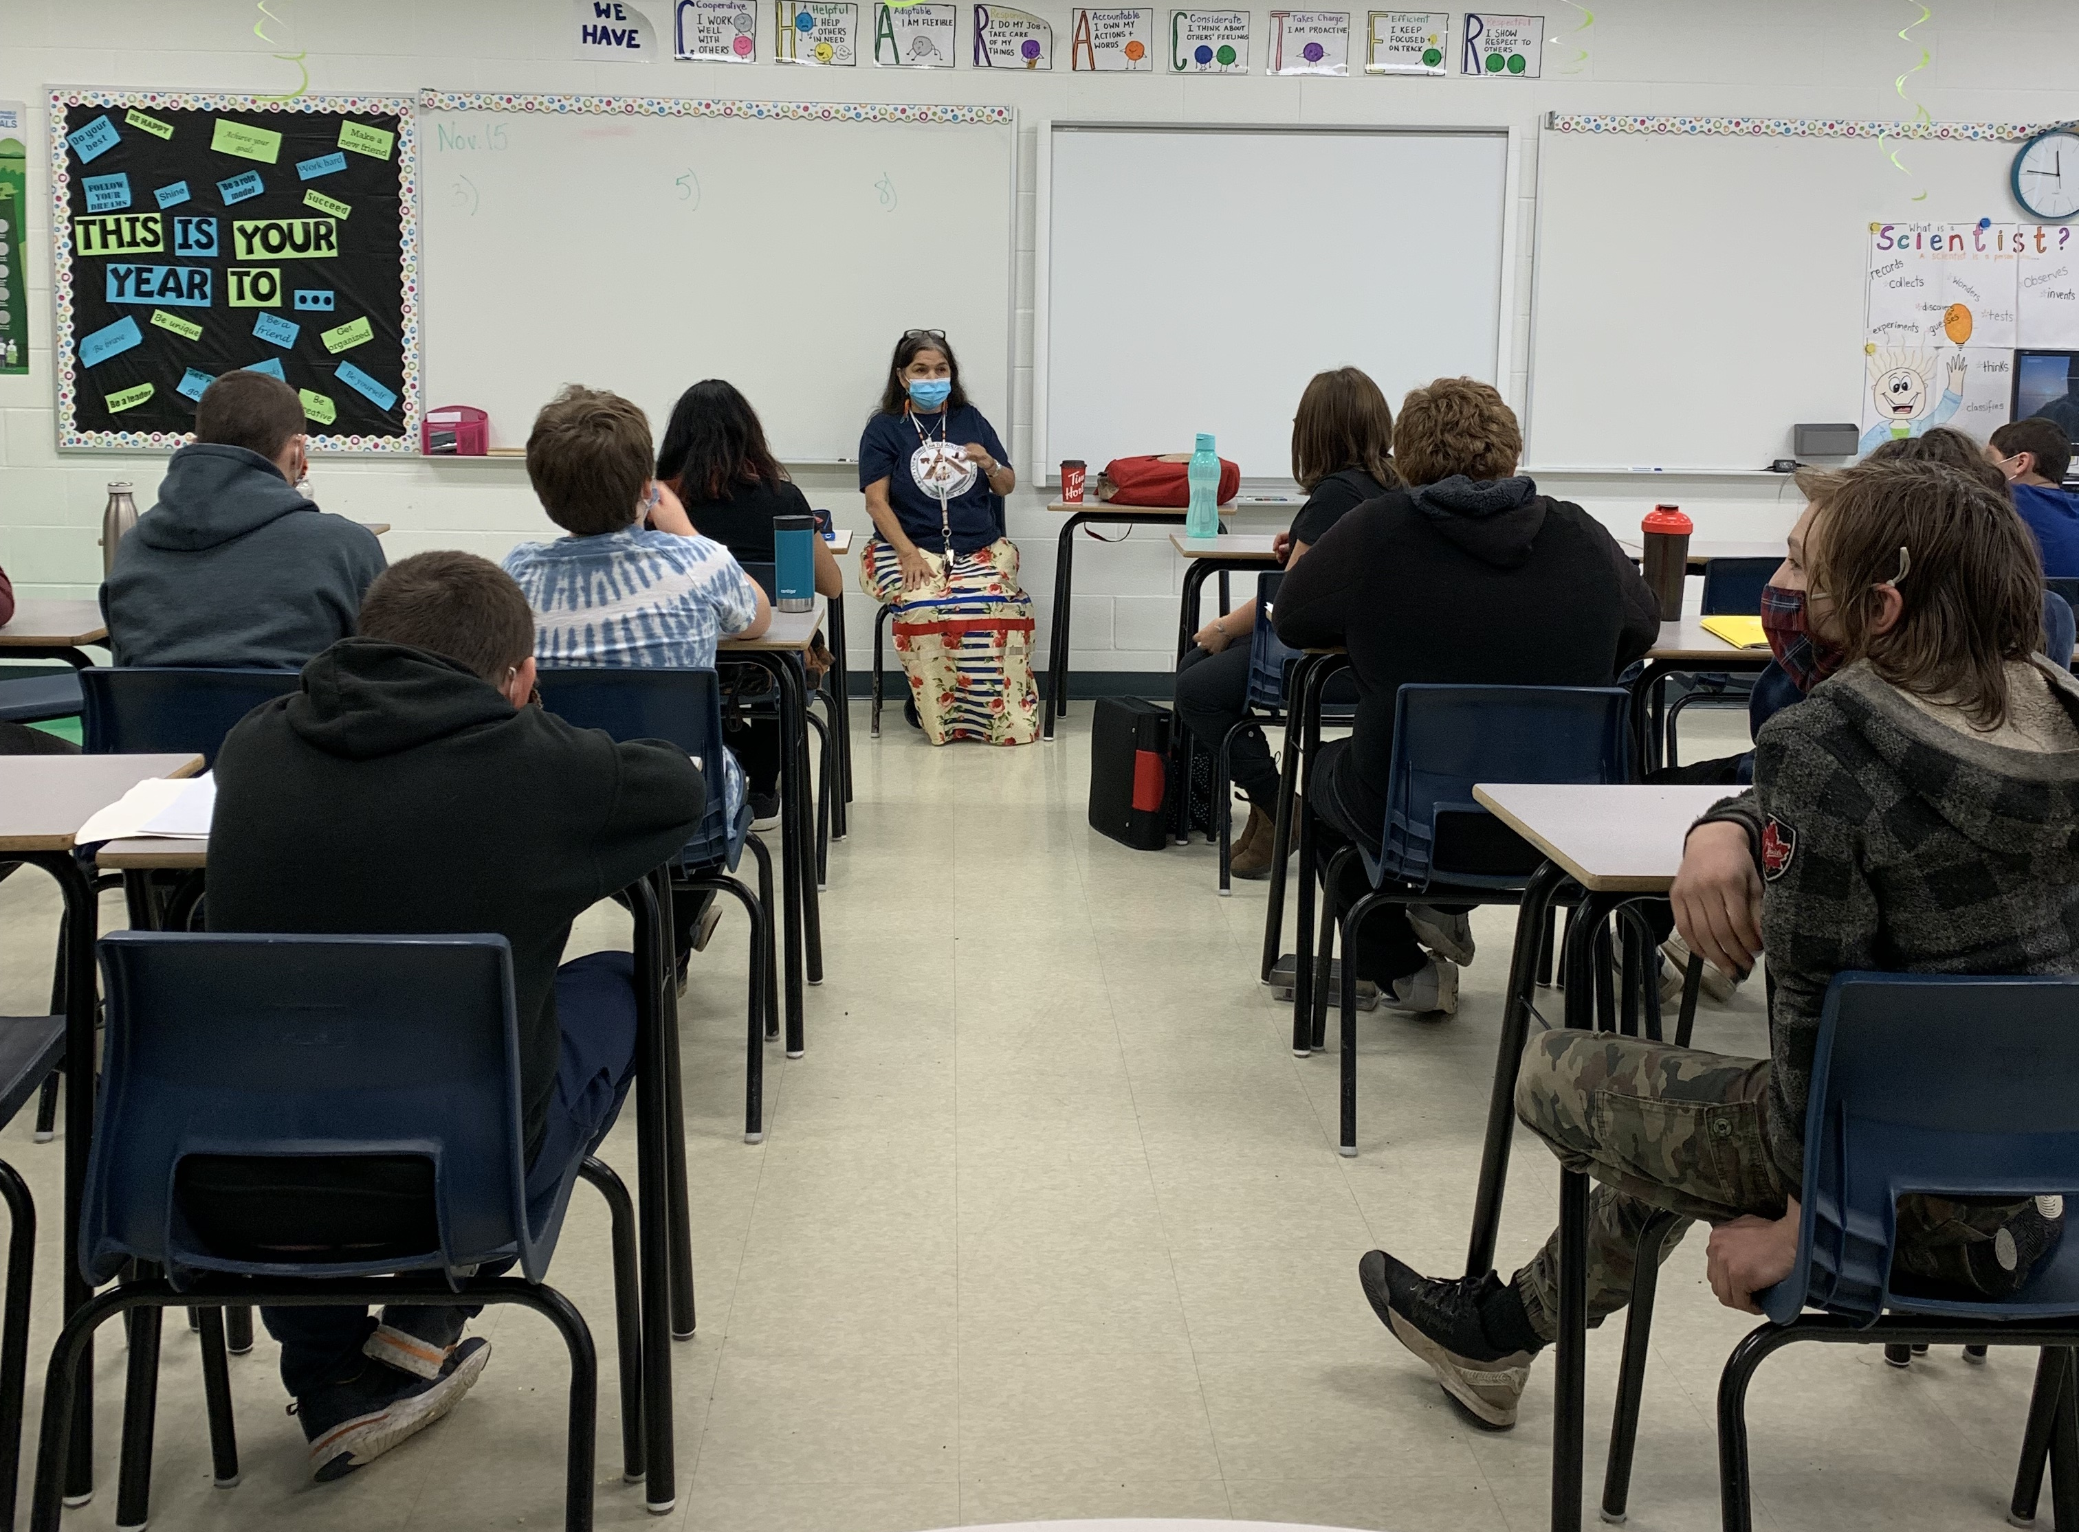
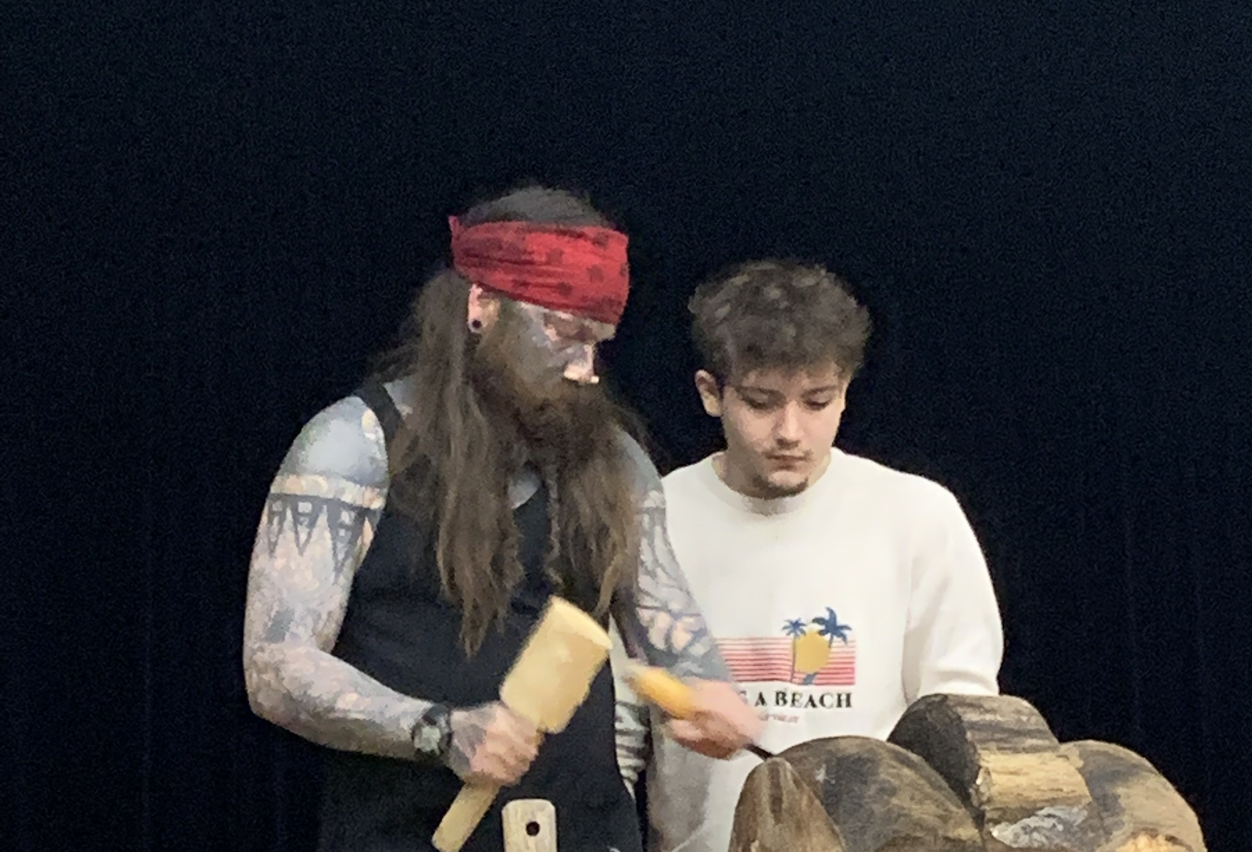
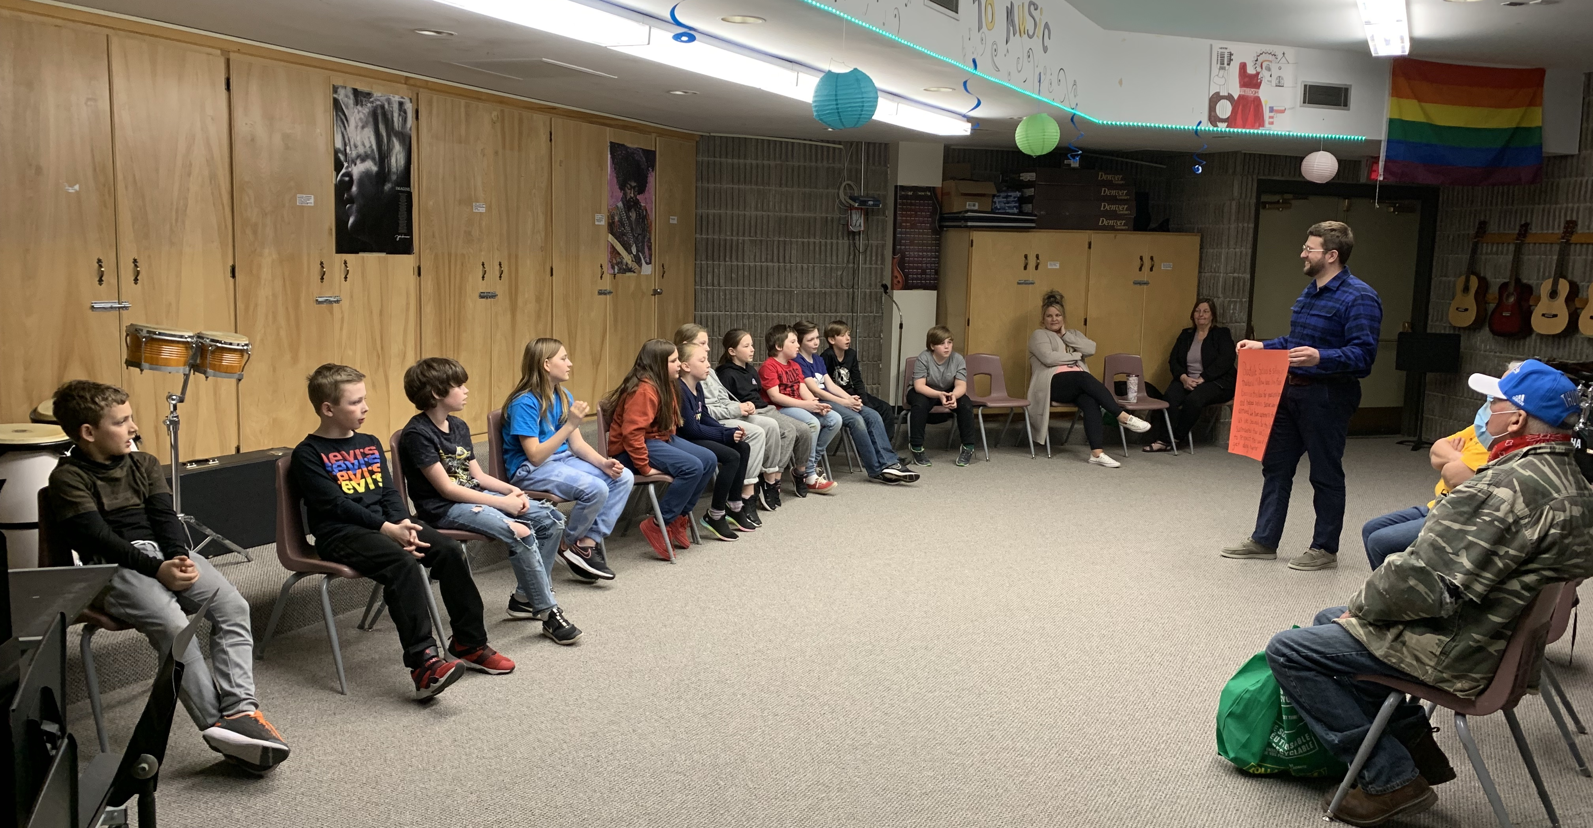
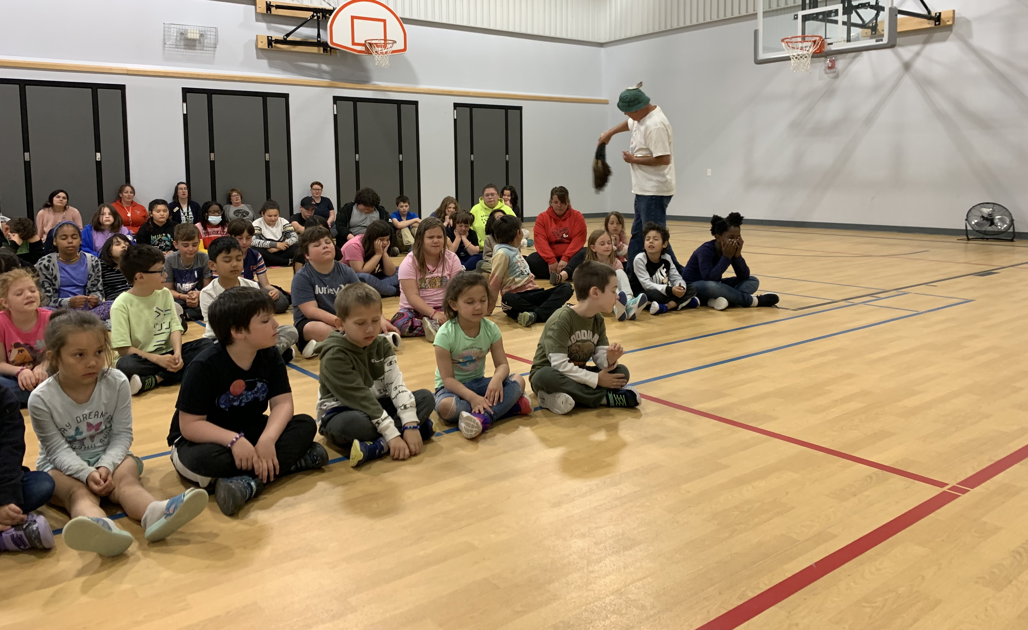
From sharing important lessons, to sharing their craft, to being featured in and giving feedback on student projects, Elders in Schools play many roles in the classroom.

Slide 17
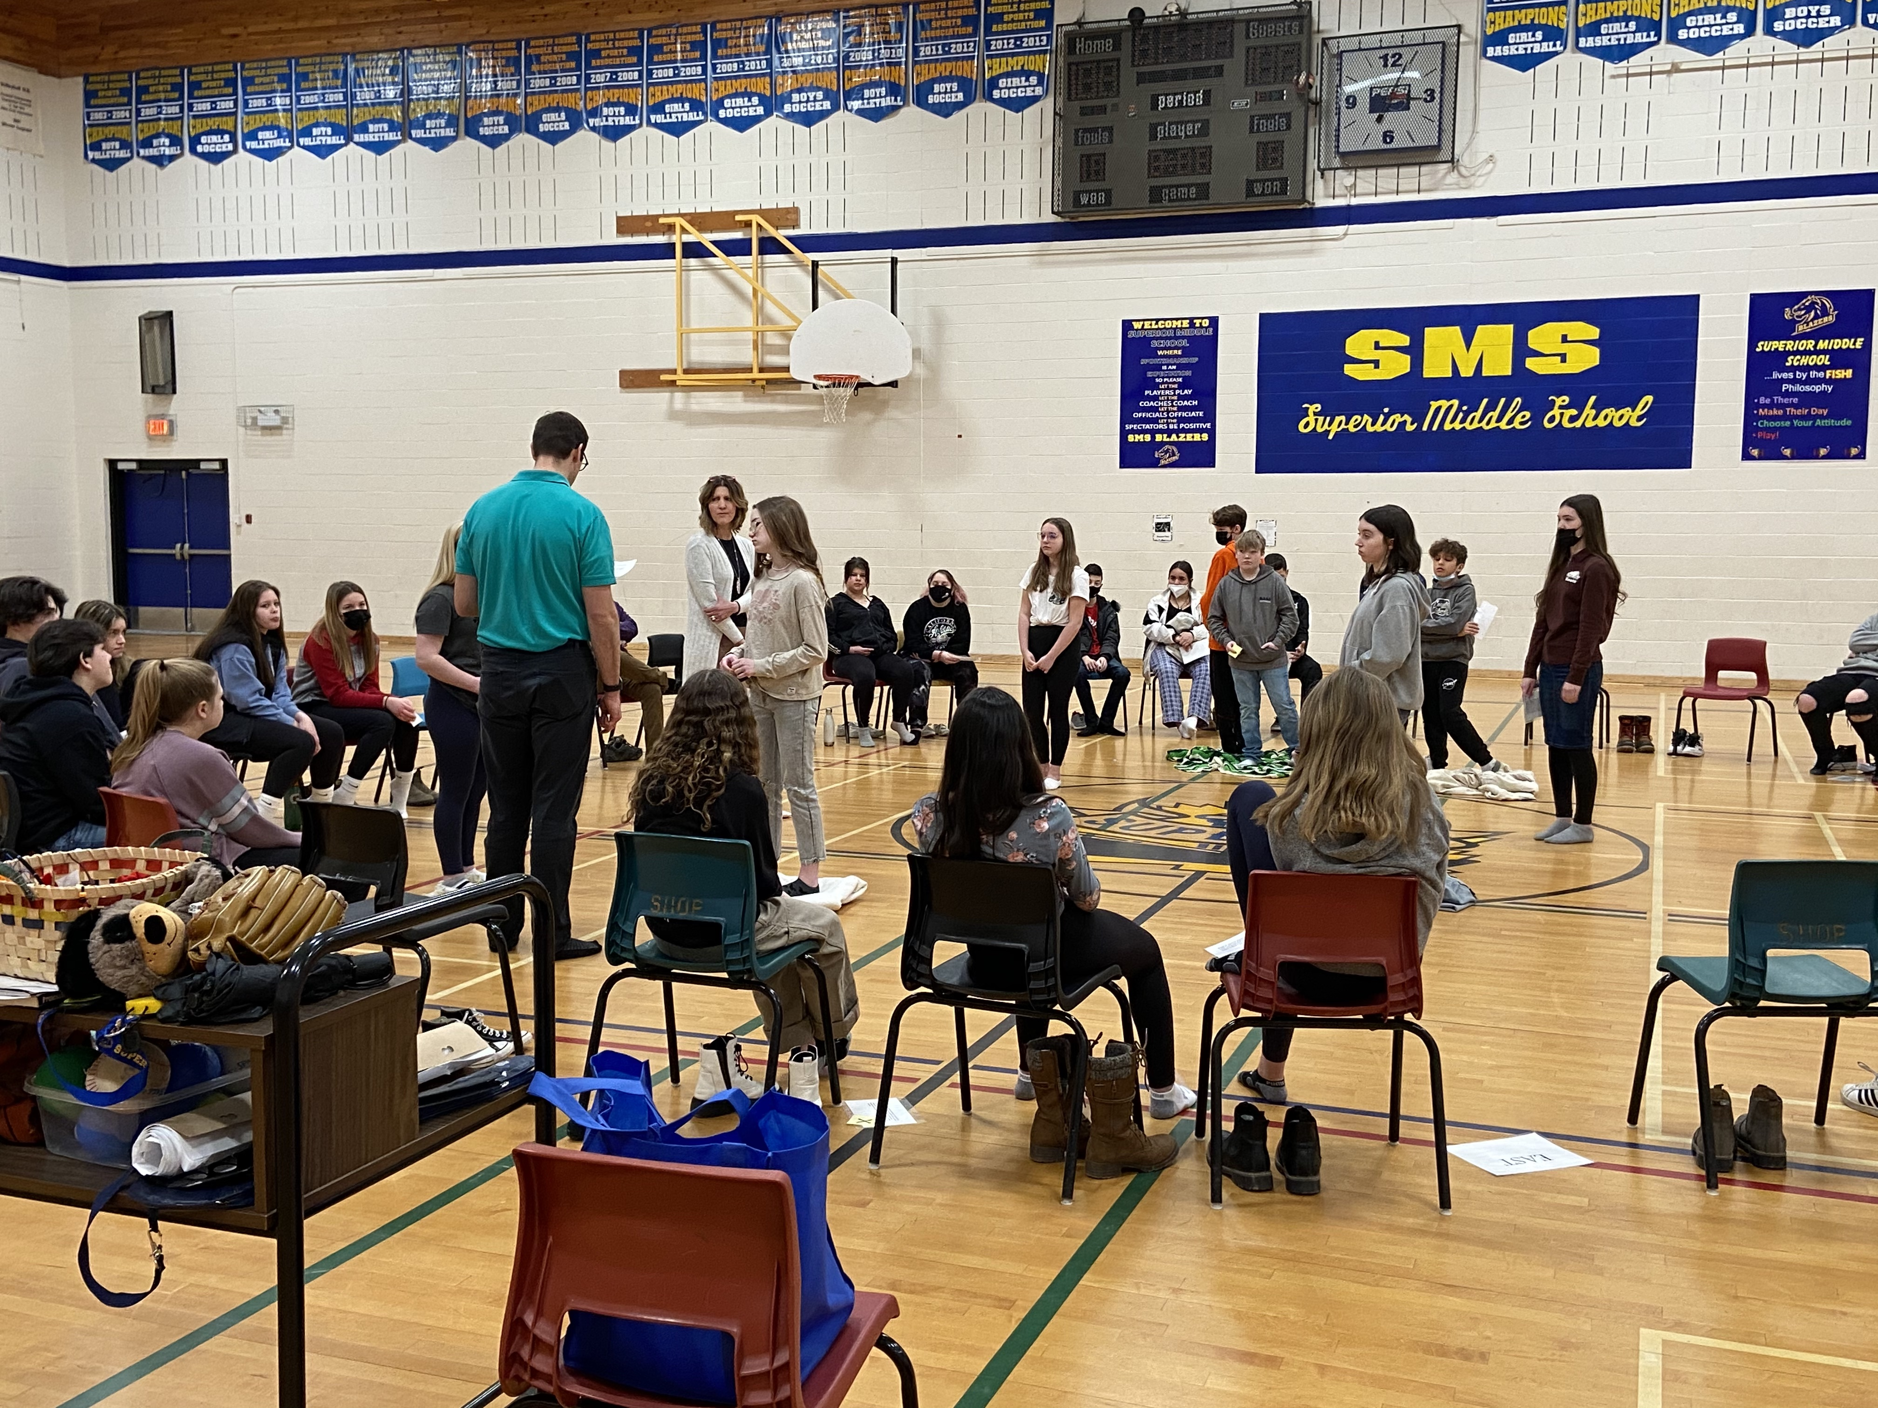
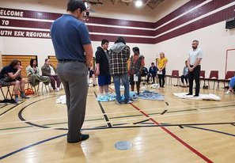
Blanket Exercises
Conducted for grade 8 students at Superior Middle School as the culmination of their Heritage Fair projects
Conducted for middle and high school students at NSER

Slide 18
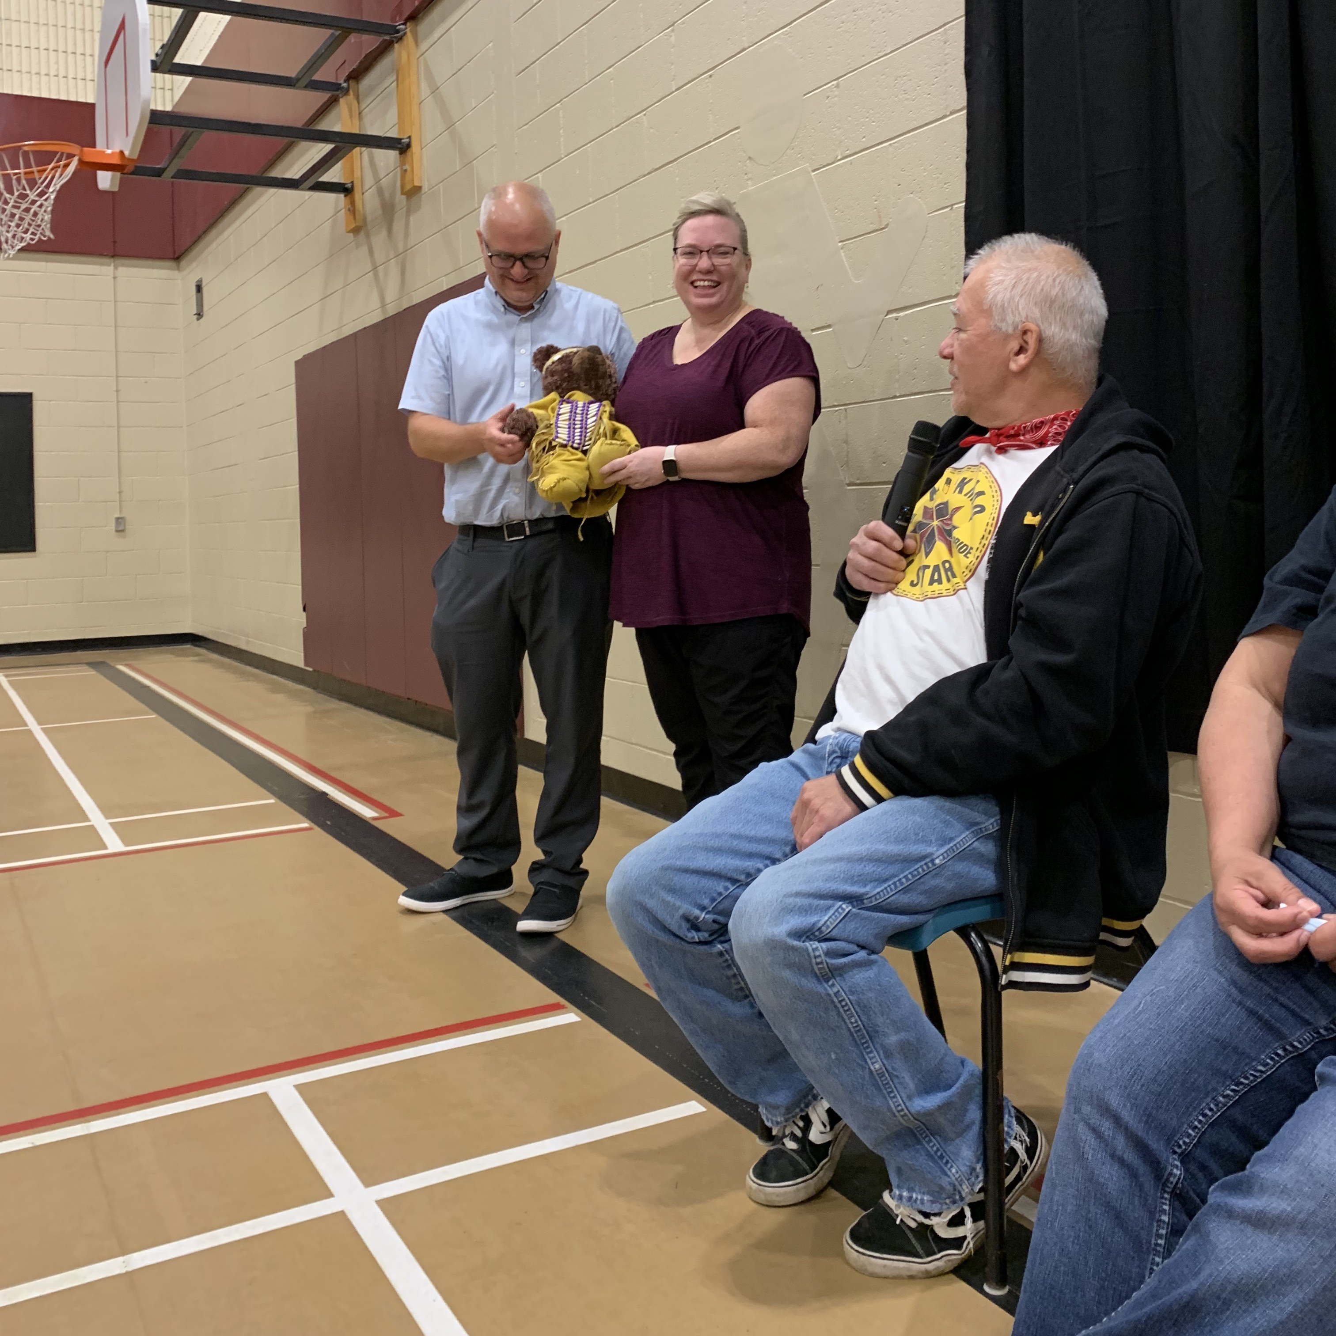
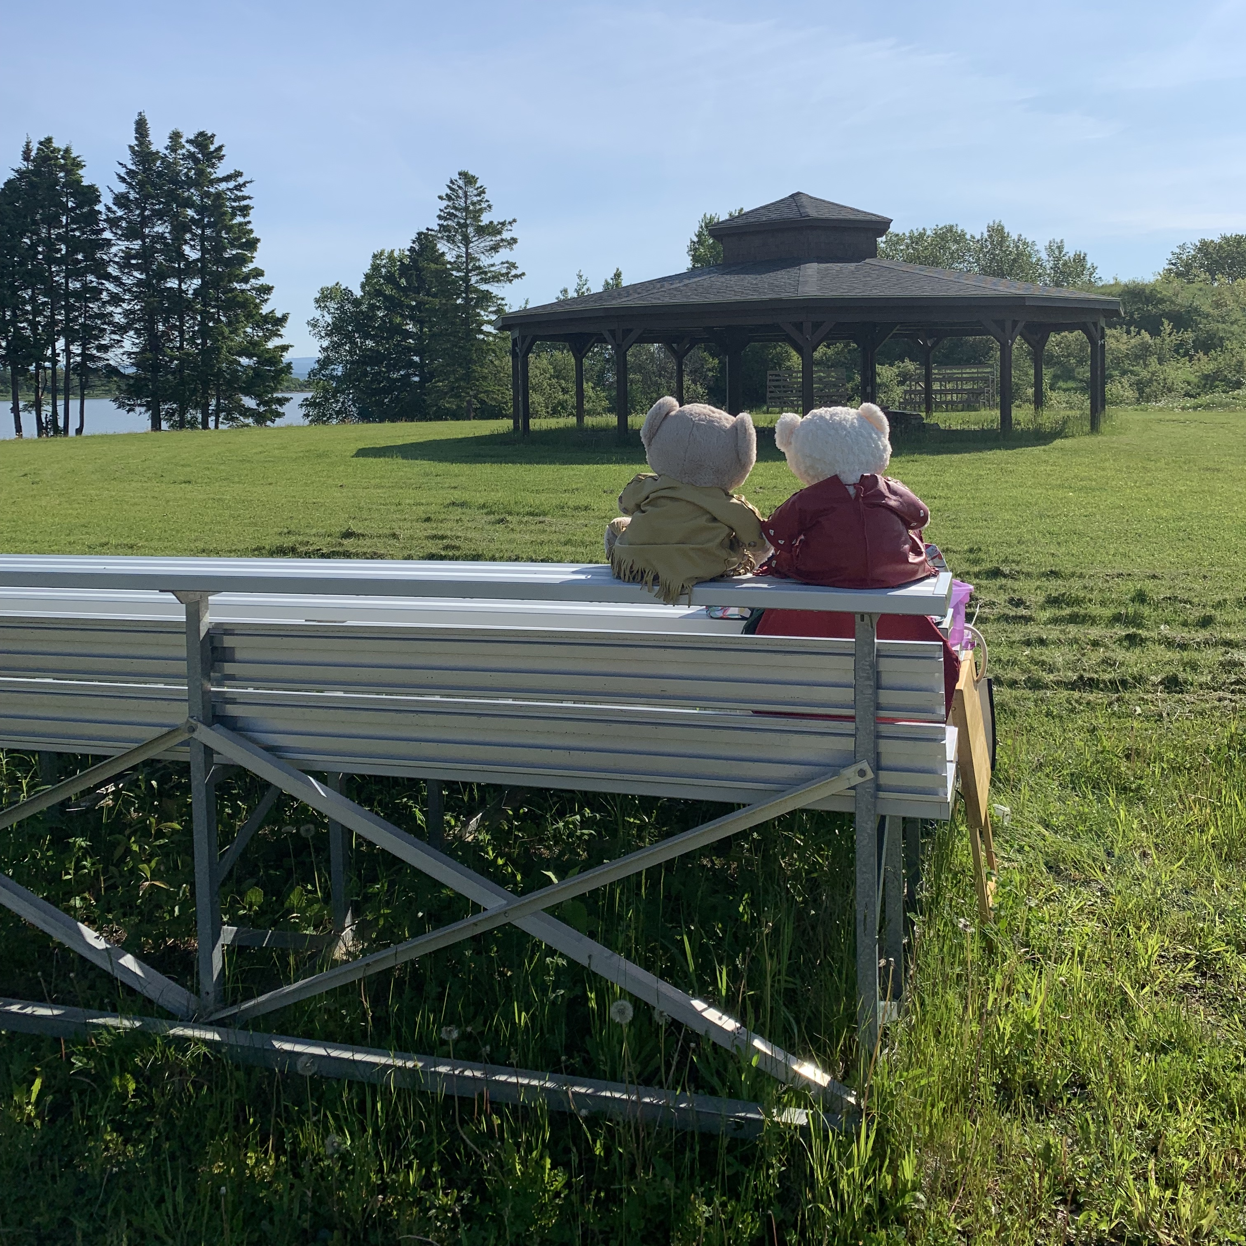
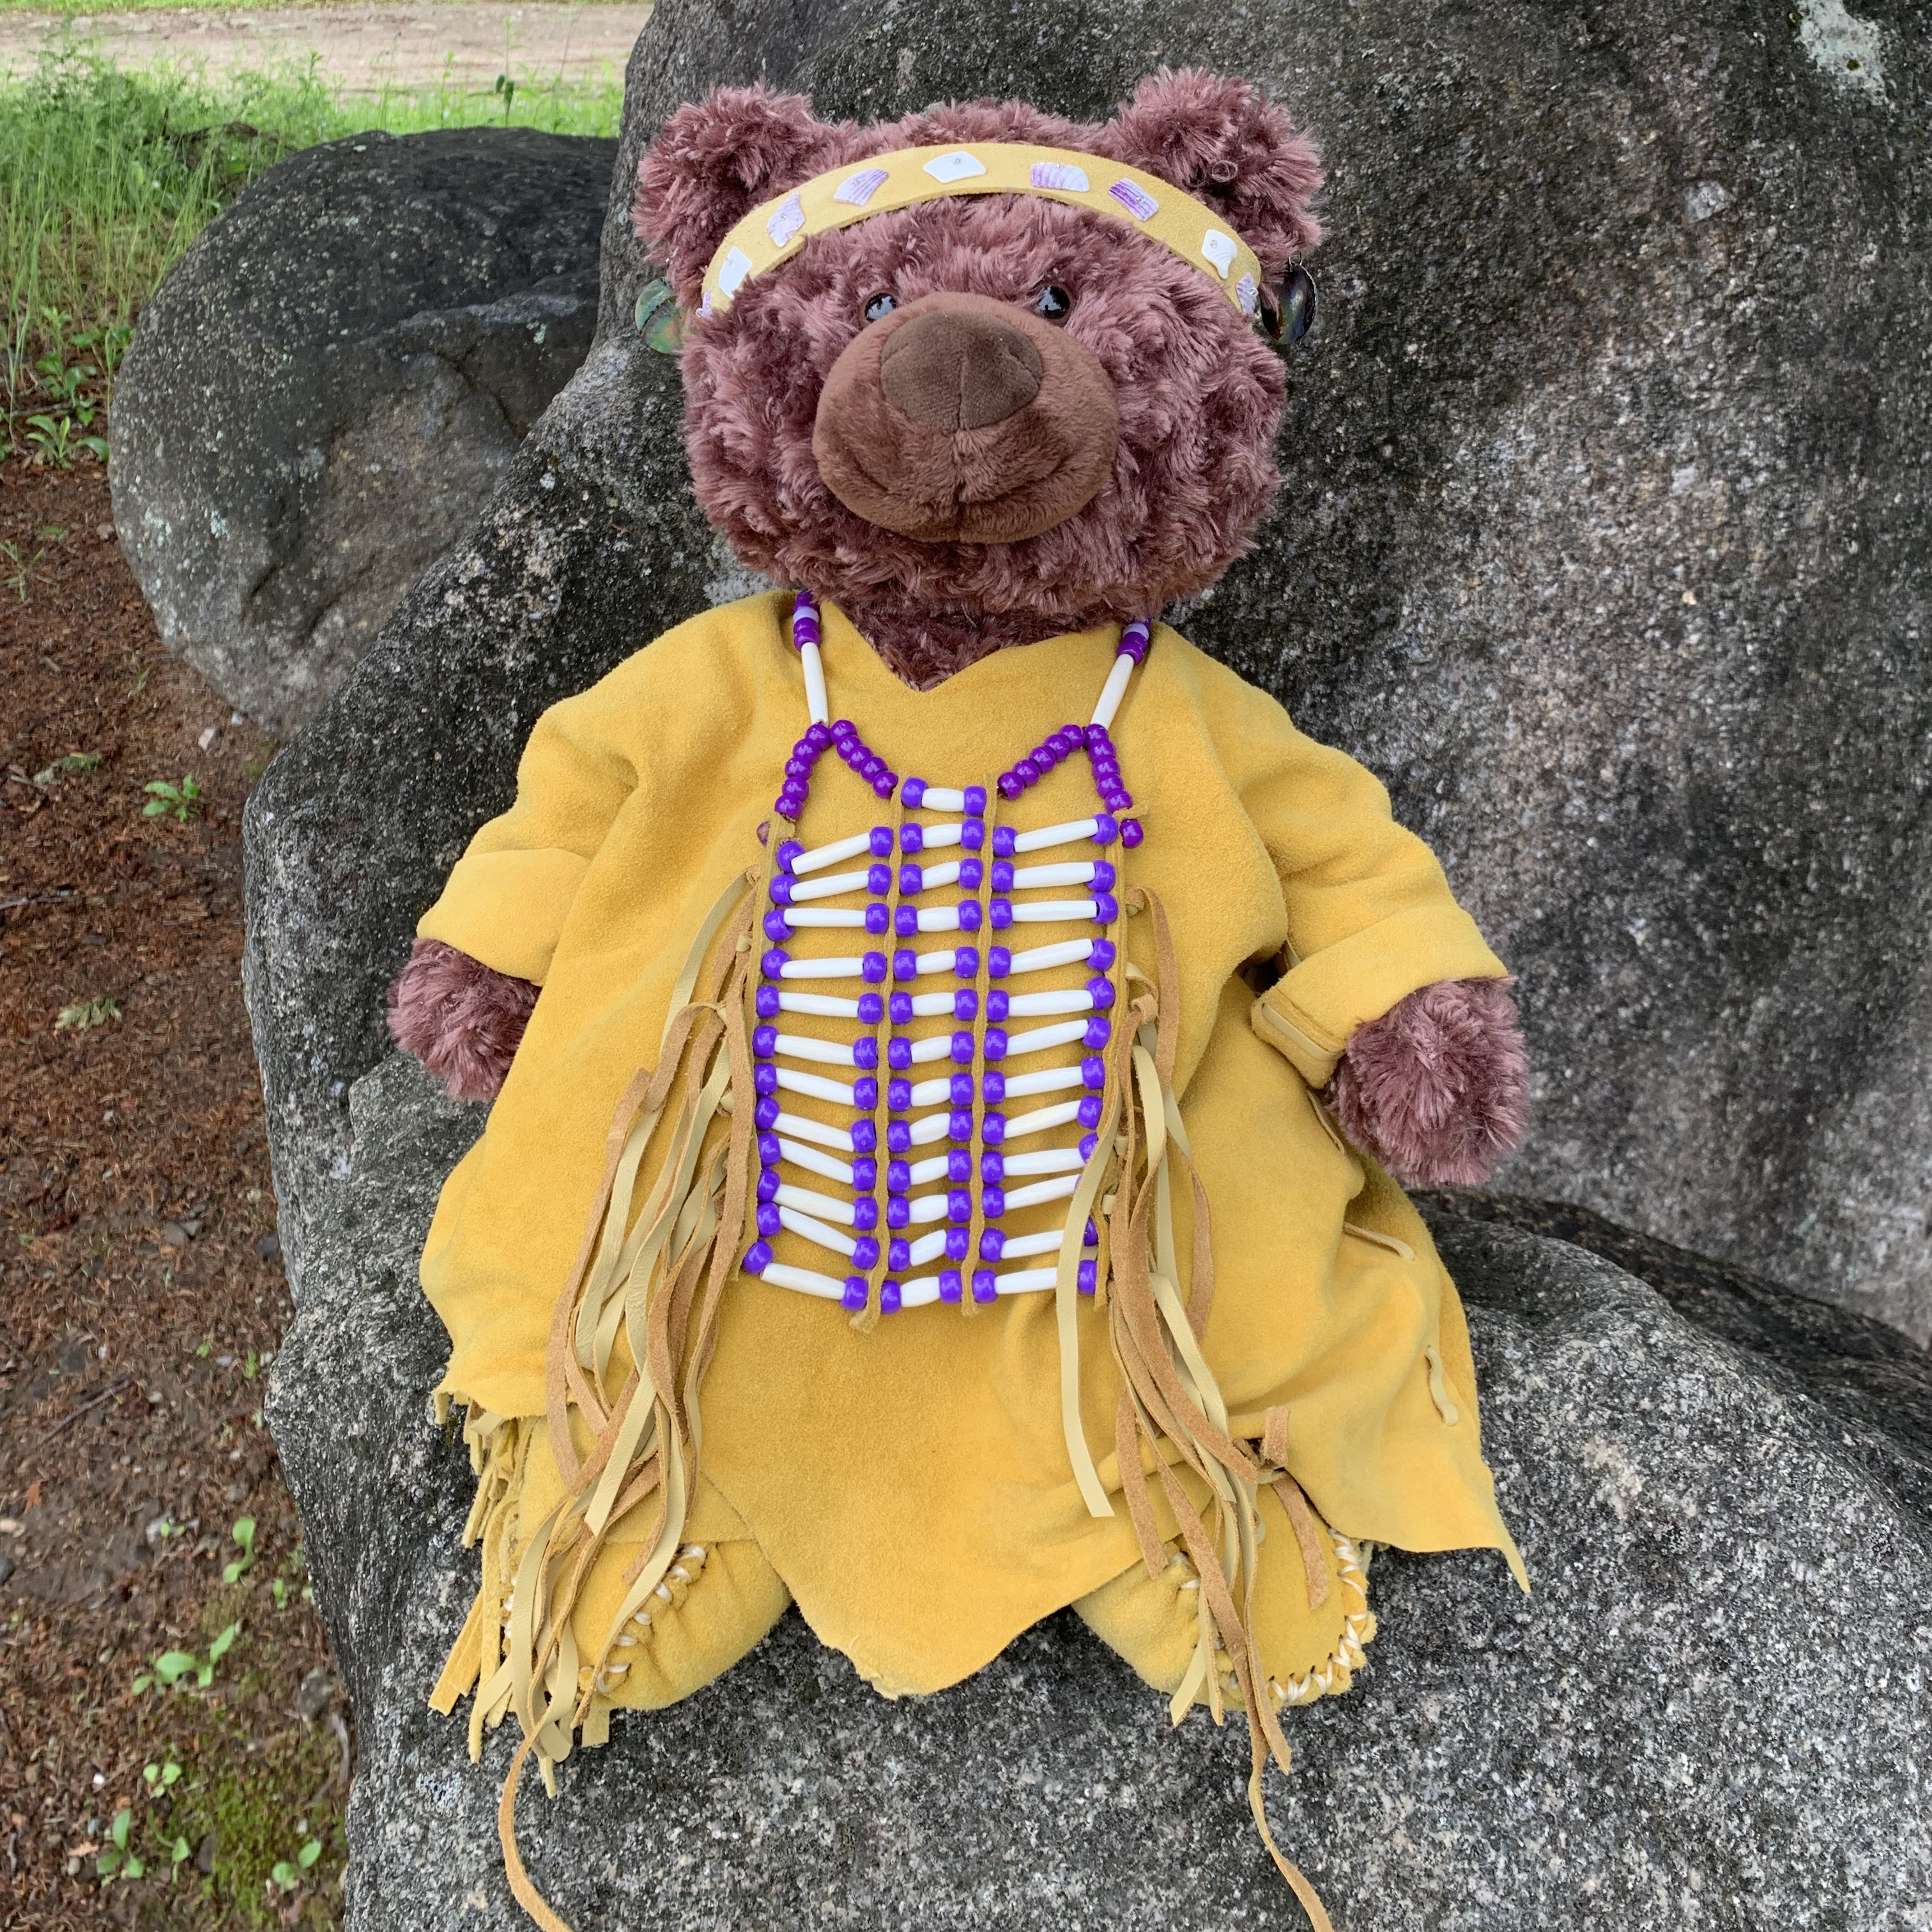
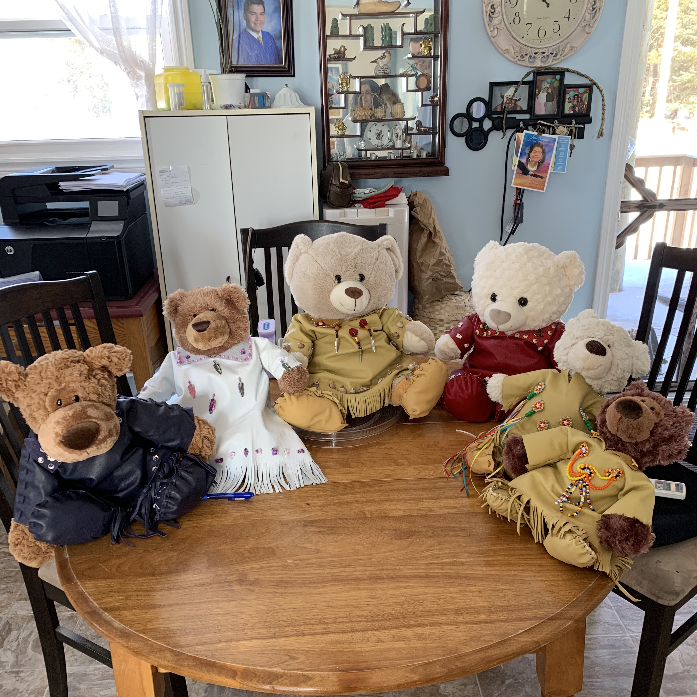
Am"bear"risters
Two Am”bear”risters have been busy visiting schools throughout ASD-N. Their aim is to help students learn about the strong, vibrant culture of Indigenous peoples and nations with a specific focus on Mi’kmaq Nations. They also help to teach our youngest students about the hardships Indigenous people face and how everyone, young and old, can be an ally. They will also be making their way to WIPCE in Adelaide Australia to present their work to educators from all over the world.
Meanwhile, after two years of work at NSEE, one patient am"bear"ister finally received his name in a traditional naming ceremony – meet Elapalin, which means Splash in Mi'kmaw.

Slide 19
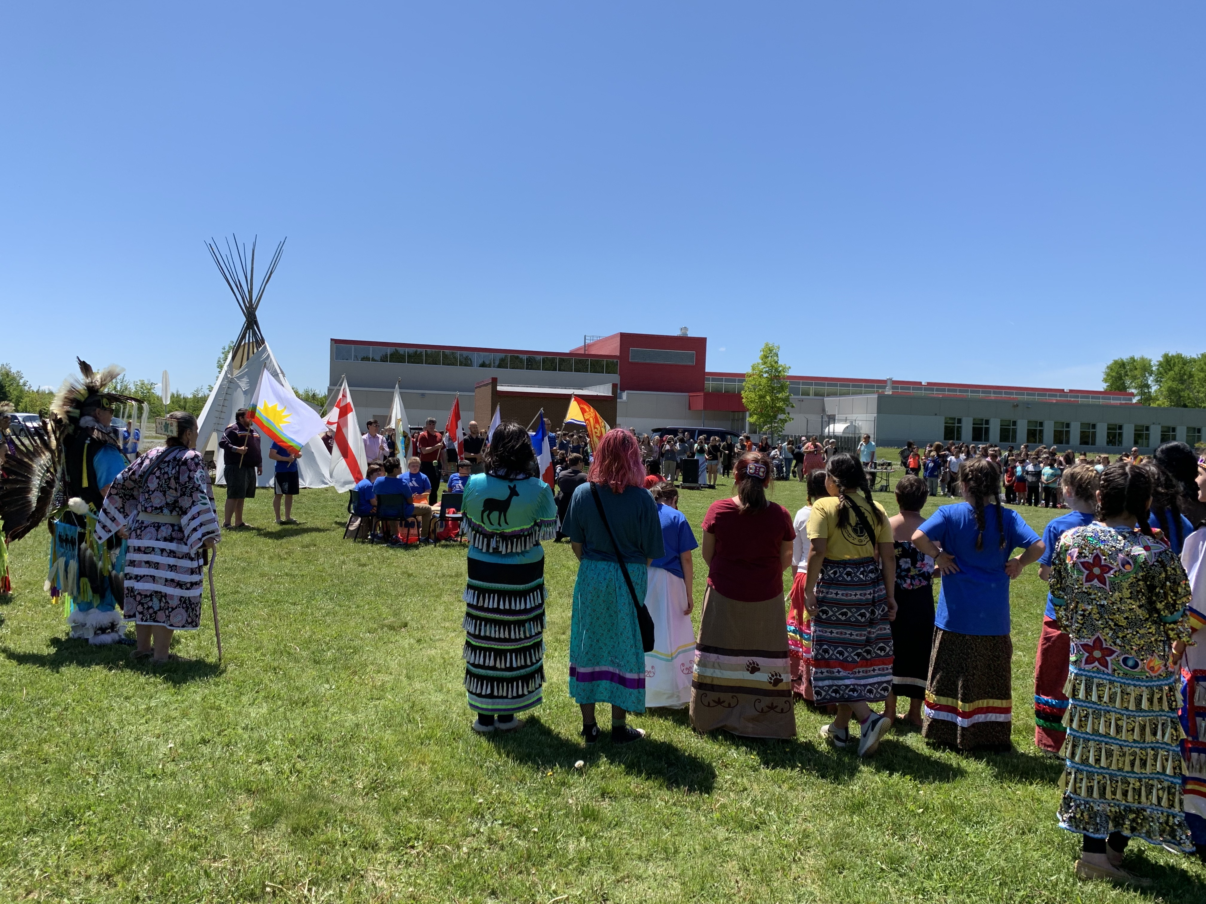
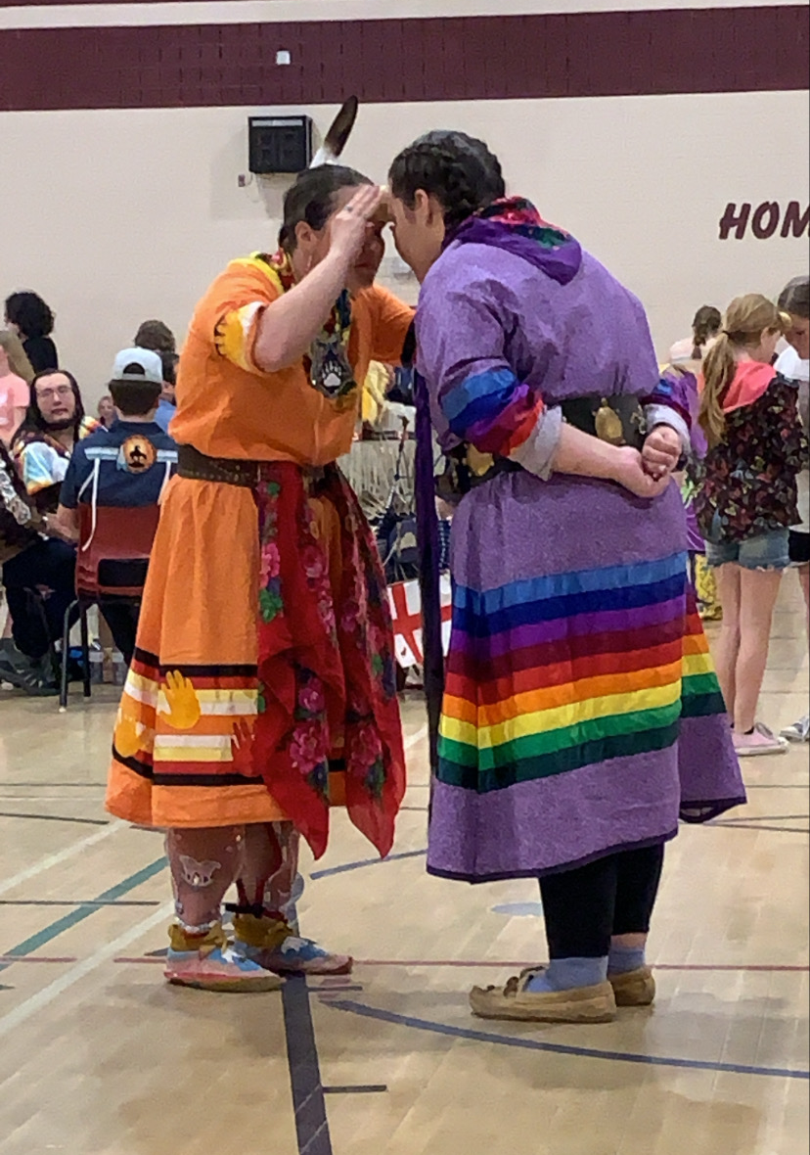
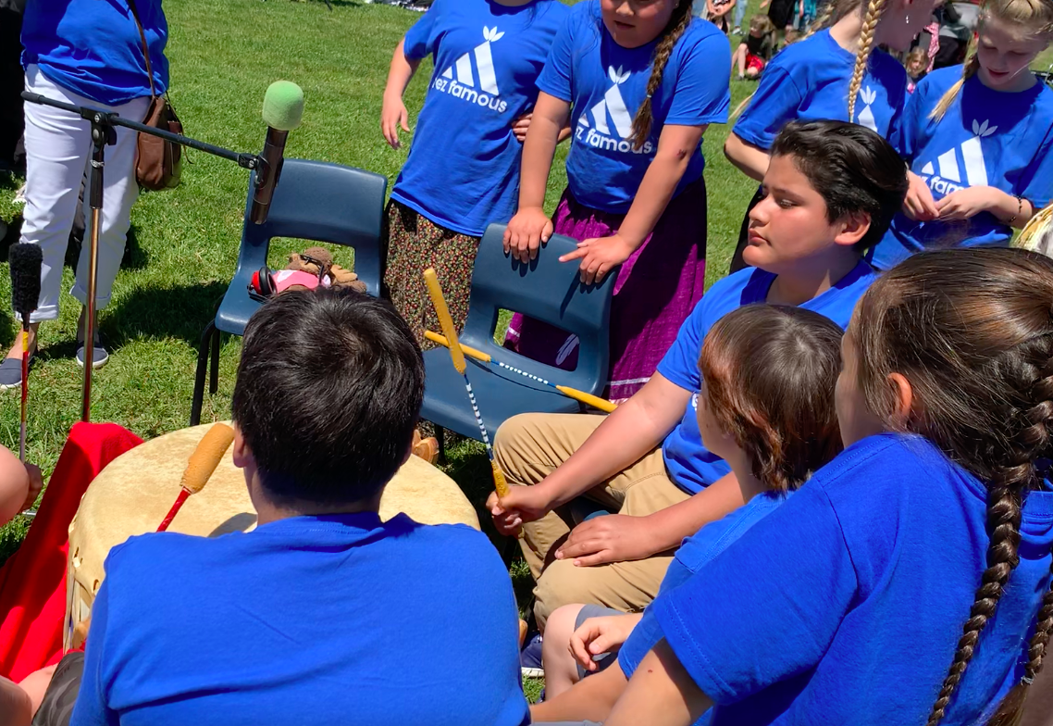
Mawi'omi's- Pow Wows
Hosted at NSER, organized by Liam Watson
Hosted at EWG, organized by Rosalie Barlow
ASD-N supported both planning committees and provided funding for drum groups

Slide 20
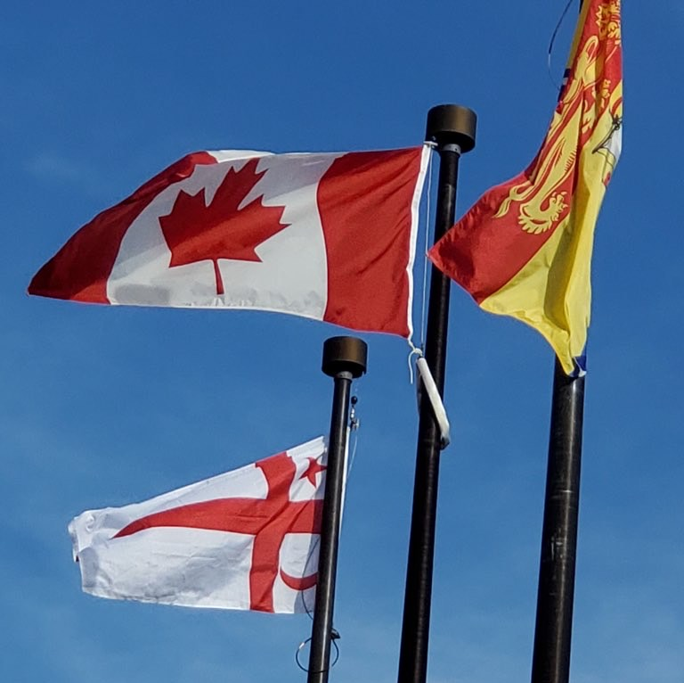
Mi'kmaq Grand Council Flags
6 schools in ASD-N have raised the MGC flag permanently
Rexton Elementary
Eleanor W. Graham
Bonar Law Memorial
Nelson Rural
North & South Esk Regional High
Sugarloaf Senior High School
3 more in progress
Dalhousie Regional High School
Millerton School
Tabusintac School

Slide 21
Partnerships
Early Childhood
Professional learning provided for early childhood educators
University of New Brunswick
Seminar session provided for First Nations Education cohort
Elsipogtog School
Provided support for educators piloting PowerPlay Young Entrepreneurs
MAWIW
Partnered for event at Queen Elizabeth Park on National Day for Truth and Reconciliation
Community Approach to Education
Enhanced First Nation Education & Services Agreement

Slide 22
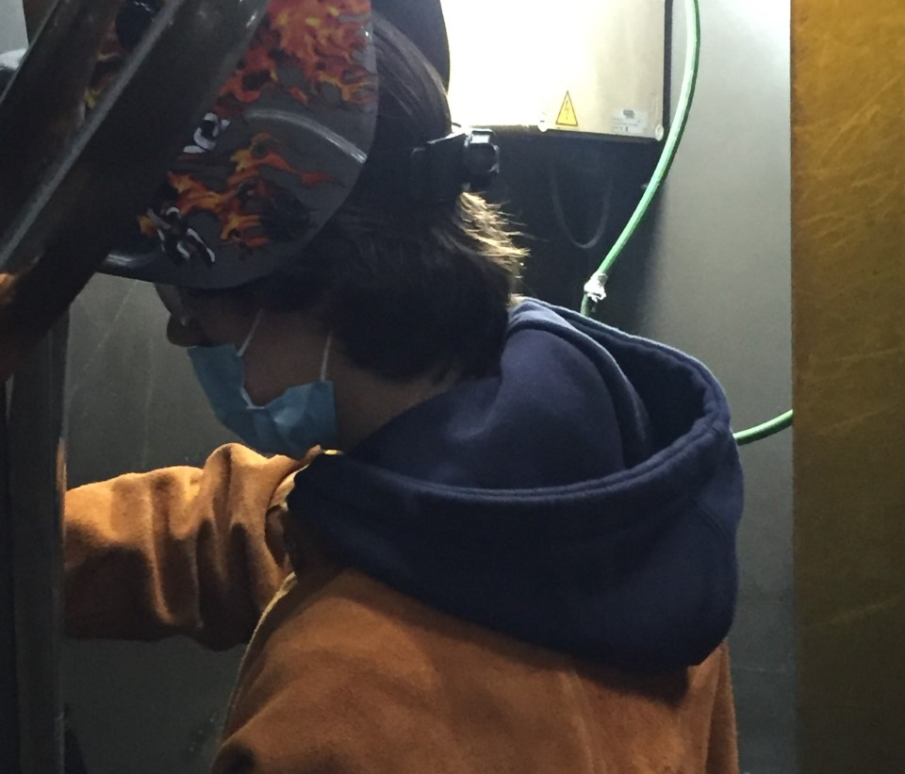
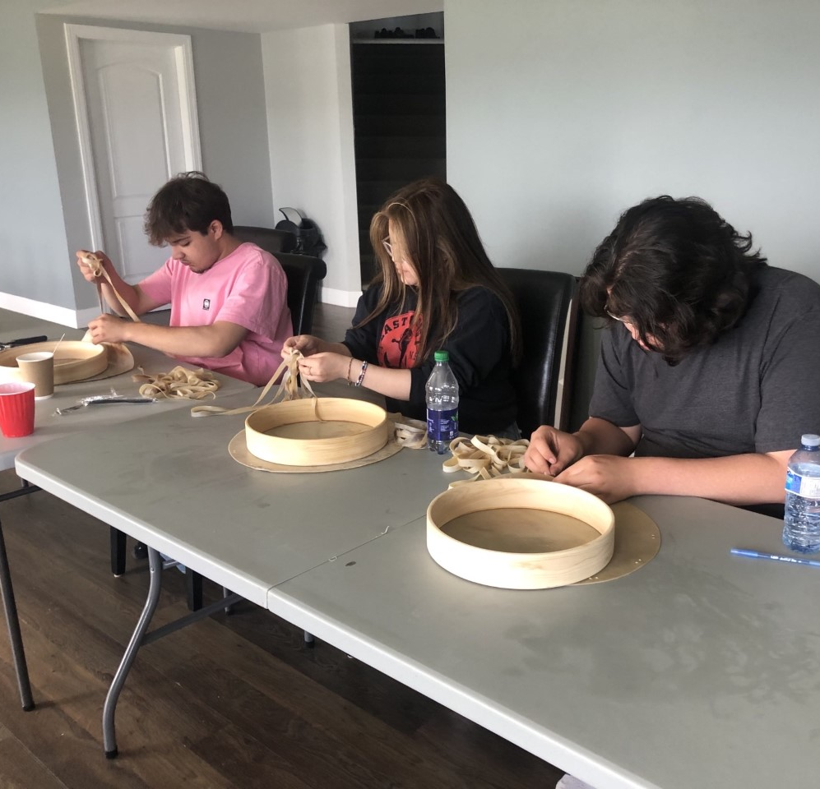
Community Approach to Education
Esgenoopetitj Site
10 students were enrolled semester 1 for Electrical Course
Students built a shed and warming shelter for the community rink which they helped assemble.
Received training and certification in First Aid through St. John Ambulance
Natoaganeg Site
8 students were enrolled semester 1 for Welding Course
One student was successful in receiving a welding ticket from Canadian Welding Bureau.
Utility trailer constructed for community
Received training and certification in First Aid training through St. John Ambulance
Semester 2-
Sites were combined and students were enrolled in Fisheries, Forestry & Community Leadership Course at the Gitpo Lodge in Natoaganeg First Nation
Students were given leadership opportunities and completed community project

Slide 23
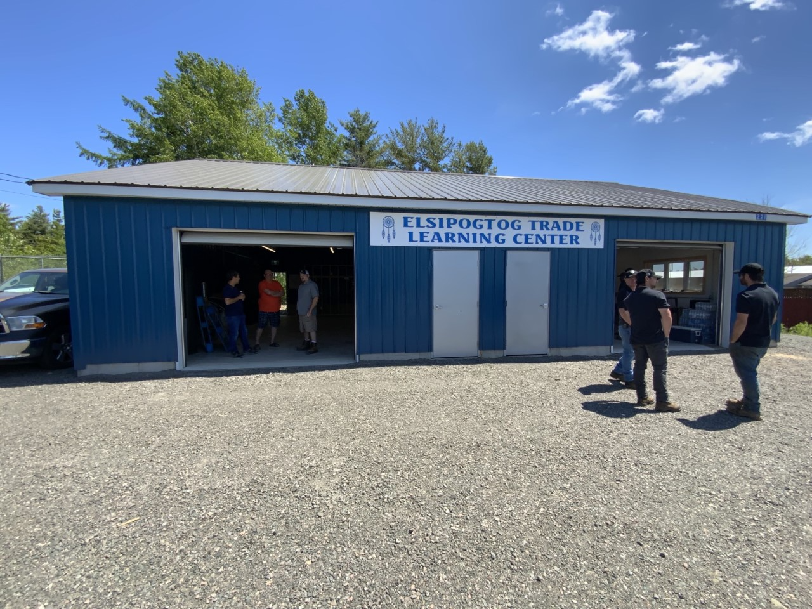
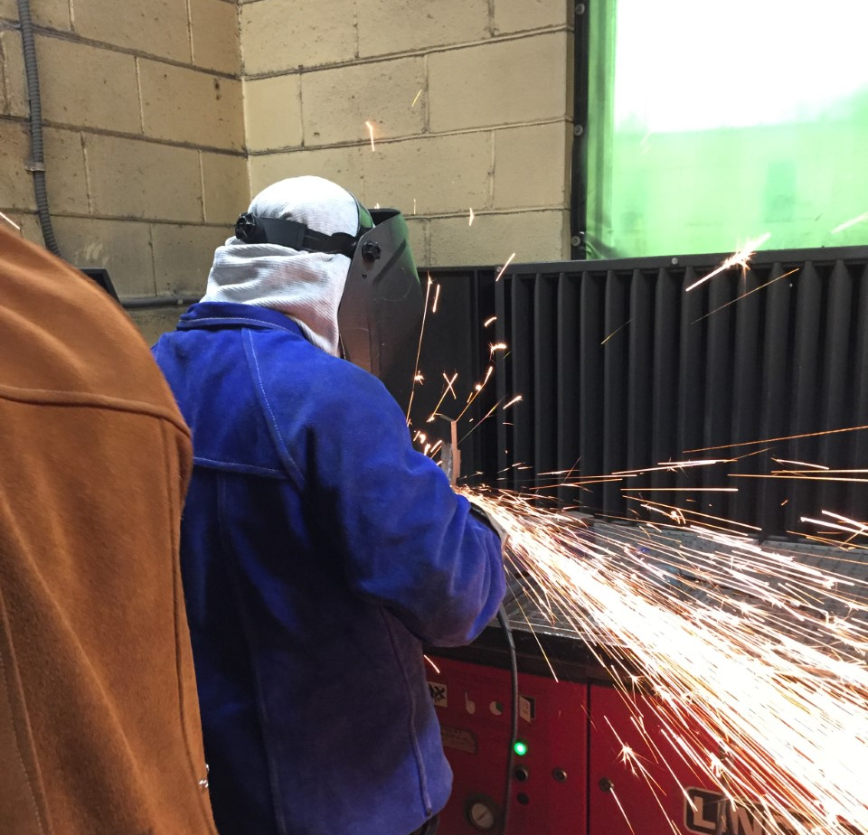
Launch in Elsipogtog
Welding Course
Elsipogtog, ASD-N, OFNE, and BLMS launched the Community Approach to Education model for second semester
A new facility was constructed and 10 students enrolled in the Welding Course
Students completed community projects

Slide 24
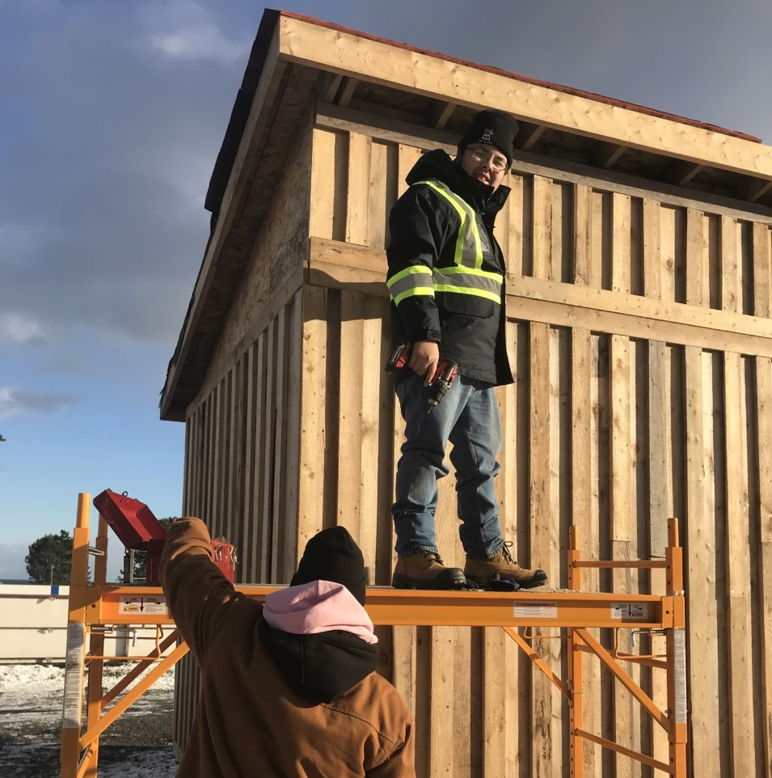
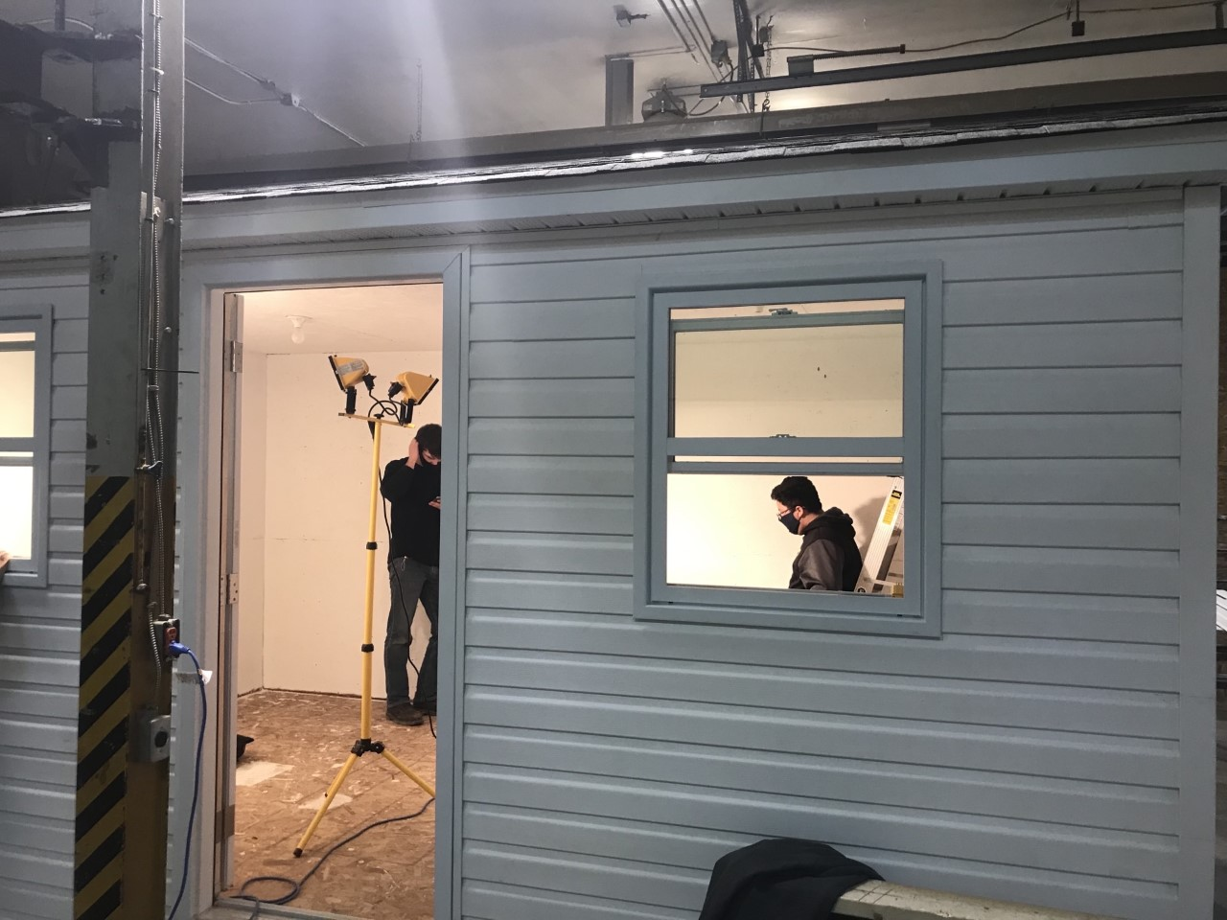
2022-23 School Year Plans
Elsipogtog will offer Electrical Course semester 1 and Welding Course semester 2.
Natoaganeg/Esgenoopetitj will offer Welding/Electrical Course Semester 1 and Fisheries, Forestry & Community Leadership semester 2.

Slide 25
Anglophone North and First Nation
Communities
are sending 32 participants to this international conference in September.

Slide 26
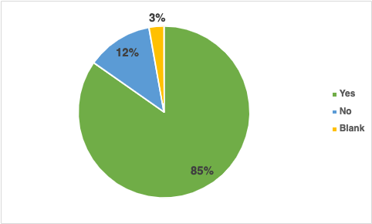
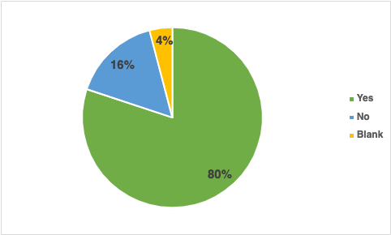
Elementary (Gr. 4-5)
Tell Them From Me
Have you learned about First Nations (ex. Culture, history, traditions) in your classroom lessons in the last year?
ASD-N has observed steady growth in students learning about First Nations people in their classroom lessons each year since first recording this information in 2017-18.
Secondary (Gr. 6-12)

Slide 27
Challenges and Areas for Growth
Teachers and adminstrators have identified the need for professional learning among administrators to support First Nations Education within their schools
Funding for land-based learning and cultural activities available to all schools
Continued work is needed to embed the Elders in Schools program in curriculum and school environement
Mi'kmaw language instructors
Elders and knowledge keepers
First Nations focused ESS needs
When new social studies curricula are released, there is going to be a big need for support for teachers to embed First Nations knowledges into lessons

