Slide 1
Spark, Build, Share
10:30am to 11:30am
In this session, you will:
View and respond to a short video on creativity.
Participate in a hands on activity designed to develop problem solving, creative thinking and team building.
Reflect on a teacher that inspired you.

Slide 2
Spark, Build, Share
Before we start the Spark, Build, Share session, we want you to organize yourselves into teams of 3.

Slide 3
Creativity
Each MLTS Learning Spark helps you to focus on an issue and will hopefully inspire you to create a micro-innovation.

Slide 4
Creativity
Discussion Questions Approx. 5 minutes (10:40am to 10:45am)
Where in school are our students at their most creative? Why?
Do our students have the opportunity to sharpen creativity through collaboration?

Slide 5
Creativity
Group Brainstorm Approx. 5 minutes (10:45am to 10:50am)
A micro-innovation is a small experiment you can plan and try quickly.
What micro-innovations could we try to foster student creativity? Teacher creativity?
Optional
Add some of the results of your group brainstorm to this Padlet:
https://goo.gl/umPqtm

Slide 7
Ready, Set, Design
Ready, Set, Design is a quick group activity. It uses simple, inexpensive materials and is an effective tool for problem solving, creative thinking and team building.
Participants are asked to solve an open-ended problem with time and material constraints. Working in small groups, solutions are developed quickly and yield surprising solutions that may not have been immediately obvious.

Slide 8
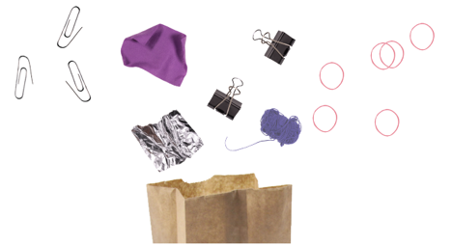
Ready, Set, Design
“Working in small teams, every group will receive a paper bag. In this bag you will find everyday materials and a challenge card. The first thing you’re going to do is read your challenge card. Your team’s job is to find a solution to that challenge using only the materials in your bag. You’ll have 15 minutes to create a prototype* of your idea.”
*A prototype is a small model of your final design

Slide 9
Brainstorming
Approx. 5 minutes (10:55am to 11:00am)
Before building, take approximately 5 minutes to brainstorm ideas.
Encourage wild ideas within the group. The sky’s the limit! Sometimes it’s the wild idea that helps form the final concept.
Go for quantity. The more ideas the better.
Write down or draw every idea the group has.
One person speaks at a time.
Defer judgment.

Slide 10
Build Prototype
Approx. 10 minutes (11:00am to 11:10am)
You have 10 minutes to prototype a solution using only the materials in your groups bag.

Slide 11
Present Prototype
Approx. 10 minutes (11:10am to 11:20am)
Groups present their solutions to the other teams. Ask a representative of each team to read their challenge card aloud and articulate how their solution addresses that challenge.

Slide 12
Ready, Set, Design Reflection
Approx. 5 minutes (11:20am to 11:25am)
What curriculum outcomes could be met using the Ready, Set, Design activity with students?
Think about a Challenge Card that could connect to a curriculum that you are responsible for.

Slide 13
Share
Approx. 5 minutes (11:25am to 11:30am)
ASD-N teachers are inspiring students to develop their creativity everyday.
Take a few minutes to think about an educator that inspired you.
This could be a teacher from elementary, middle school or high school, it could be a university professor, it could be a sports coach, it could be a colleague.
Share with your group what made this person inspiring.
What common characteristics do these educators have?

Slide 14
Mr. Smith
inspired me.
#inspiredbyteachers
We invite you to write the name of a teacher that inspired you on a piece of paper and post the image to social media with the hashtag, #inspiredbyteachers

Slide 15
AGENDA
9:00 - 9:30
9:30 - 10:00
10:00 - 10:30
10:30 - 11:30
11:30 - 1:00
1:00 - 1:50
1:55 - 2:45
3:00 - 3:30
Welcome and Opening Message
Innovation in ASD-N
BREAK
Spark, Build, Share
LUNCH
Sessions A
Build Challenge
Sessions B
Build Competition and Closing

